Slide 1


Improving children's services decision making with family context Discovery project – final report
12 January 2019

Slide 2













Executive summary – project context Leeds, Stockport and Social Finance wanted to understand what information would improve decisions
Earlier this year, Social Finance (a not-for-profit supporting government to better use data and digital in decision making) and 12 leading authorities met to discuss the barriers to improving decisions and improving outcomes for vulnerable people
We agreed to collaborate on building common tools and approaches and sharing data and learnings, and decided on two initial projects to begin this
For the first project, Leeds, Stockport and Social Finance would work together on a piece of discovery work to understand what data children’s services need to make better decisions
Our ingoing hypothesis from the experience of the authorities was that better information on families was needed – this set the initial scope for the work
We tested and investigated this hypothesis in detail using an open process, understanding the workflows, decisions and needs of users across the council
Partner authorities

Slide 3



Executive summary – project process over this 12-week discovery we have worked to understand user needs and assess which we should meet
The project had three phases:
1. Understanding needs
We had 60+ semi-structured interviews with staff across the councils to understand their workflows and decisions they make regarding families as well the information they have, their needs and their painpoints
We grouped these users into five major personas, with a profile, workflow and key user needs highlighted for each
2. Testing and prioritisation
Next we tested these findings and prioritised which needs were most important
To do this, we ran show and tell workshops with the users, met with project and senior leadership, performed further interviews, ran a survey and held a workshop with other authorities to test how the needs applied to them
The greatest priority need that emerged from this process was that Social Workers need to know what services are engaged with a family (and the contact details for the lead professional in each) at the point of performing a Social Work Assessment
3. Assessing options
In the final phase we explored how we could meet this user need
We worked to understand in more detail precisely what information is needed, tested mock-ups of potential solutions with users, assessed the business case for acting, scanned the market for existing solutions addressing this need and created a plan for what to build in a potential alpha project
Finally we took this through a gateway process with senior leadership to assess whether to progress to alpha

Slide 4
Executive summary – general findings Overall we found strong demand for family information across users and authorities
There are very similar needs across the two councils, but also between users within councils
Although systems and service structures differ between the two councils, we've found that the vast majority of underlying user needs are common
We’ve also found strong commonality in needs between users within councils (particularly Early Help & Social Work). These overlapping needs are driven by common and fundamental root causes e.g. lack of a systematic way to share data between services impacts all front-line workers
There is very strong demand for better basic information on families
Frontline workers lack basic information on who a child's family are, who they live with and what services the family interacts with. This information is essential to making the right choice on what support to offer at time of assessment, intervention planning or point of closure. A Chief Social Worker said: ”One piece of information can change the decision for a family"
Leadership lacks a view of what services interact to support families and where this works well or not e.g. when deciding which services to commission or how to improve operations
Lack of this data undermines practice and increases risk
For the most important "set piece" decisions (e.g. MASH/MASSH, MARAC) both councils do have effective, but person-intensive, manual sharing processes through having every service present in a room – this works well for the immediate sharing but, less well for ongoing sharing, outcome tracking or out-of-hours. It would not be affordable to co-locate services for all decisions
Without a systematic way to get family information, both Early Help and Social Workers are currently using ad hoc and lengthy "detective“ or “fishing” processes. This often depends on personal relationships and workarounds. This wastes time and increases risk of missing factors or inappropriate sharing

Slide 5
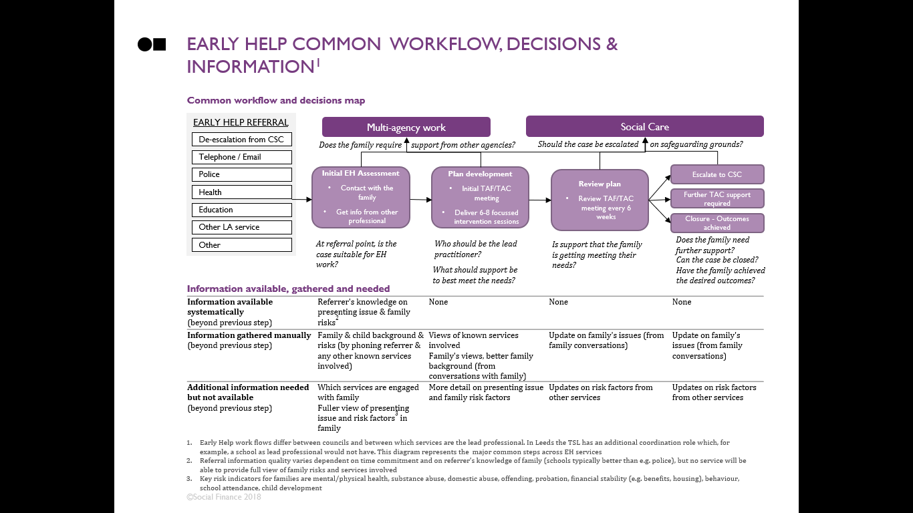
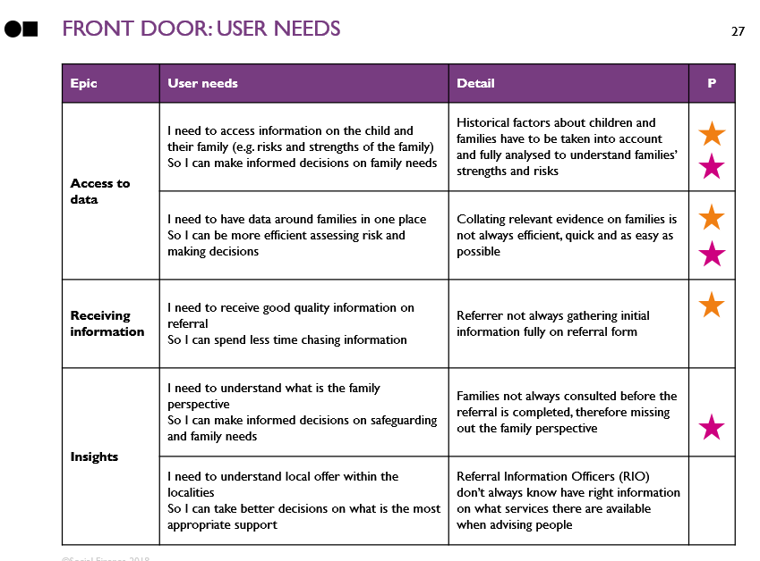
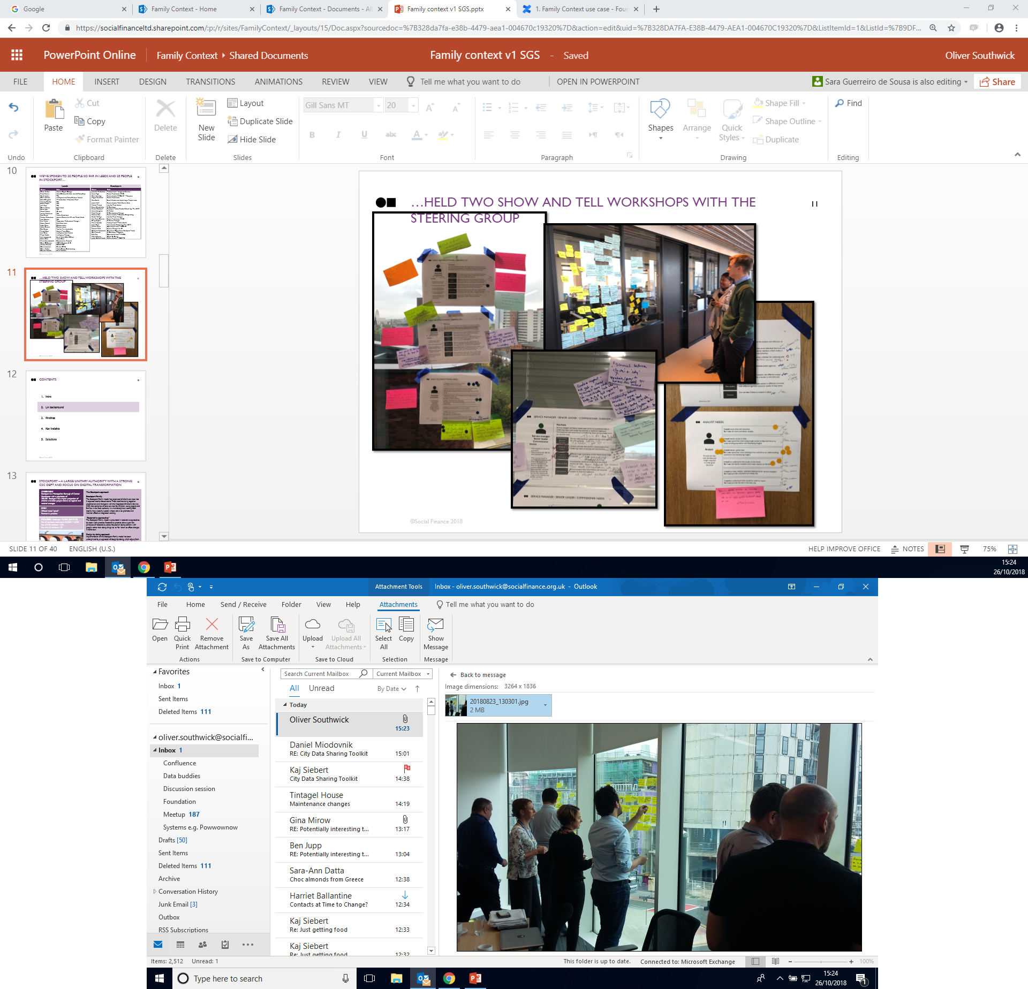
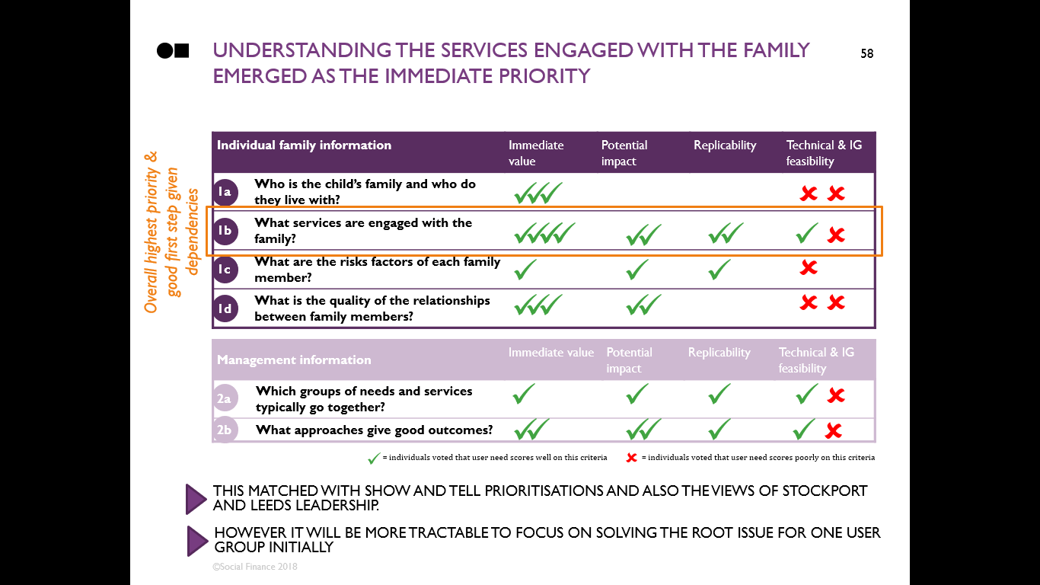
Executive summary – prioritising one user need WE captured our findings as a longlist of user needs, which we then prioritised to find one need
From our interviews we detailed a set of user personas, profiles workflows, decisions and needs
We captured the findings of our 60+ interviews by creating personas for different user types, writing a profile for each, mapping their workflow and decisions and listing the needs they expressed
We tested and prioritised these needs through workshops with users and leadership
From the longlist of user needs we successively prioritised the most important with users, leadership and the wider group of authorities
The priority need identified was an easier way to find what other services are supporting a family at the first point of engaging with them and have the contact details for the lead professionals to enable conversations and ensure relevant information is not missed
This need was expressed by Social Workers, Early Help and the Front Door. We assessed which group it would be most feasible and impactful to address this need for first
This suggested that Social Workers were the best choice as they had expressed the need more strongly than the Front Door and would be more feasible than Early Help in terms of Information Governance and commonality across councils

Slide 6
Executive summary – the priority user need …When Social workers first assess the support a family needs, they need to speak to the other services engaged
When further investigation is needed to decide what support a family needs, a social worker works with the family and other services on a social work assessment
When a child is referred to children’s services they enter a rapid triage process at the “Front Door”, this filters out cases that clearly need immediate safeguarding action and those where social work is clearly not needed. Less clear cases are referred for a more detailed “social work assessment”
The social work assessment is performed by a Social Worker, with the aim of assessing what support the child and family needs. It can result in 1) formal support from Social Services (as a Child in Need, on a Child Protection Plan or even escalating to care proceedings), 2) in a referral for support from other services (for example Early Help or specialised support such as mental health or substance abuse), or 3) in no further action being taken
To perform this assessment, the Social Worker will read existing information on the child and family (e.g. the referral note, any case records), visit and speak to the family (except where inappropriate for safeguarding reasons) and speak to other professionals supporting the family
Currently Social Workers cannot readily find out what other services are supporting a family and who the lead professionals from those services service are
One of the key painpoints Social Workers experienced was finding out what other services were engaged with the family and getting their contact details for conversations
With no systematic way to know who else is working with the family, Social Workers currently go on time-consuming and ad hoc process to find out – they will often contact one service first and ask if they know who else is involved. This detective process typically depends on who each social worker has personal relationships with and can involve informal processes and deviations from best practice

Slide 7
Executive summary – addressing the user need There is a clear business case to develop an alpha-stage tool to address this user need
Helping Social Workers find out who is supporting a family would have significant benefits:
Better support and outcomes for families – knowing who is involved and having the right conversations will mean Social Workers have the full picture, do not miss risk factors and can have better quality interaction with families, meaning they can ensure families get the right support first time. Currently 23,000 children a year (10% of NFA referrals) across the UK have to be referred to children’s services multiple times before they get the right support¹
Cost savings – ensuring children and families get the appropriate support will help stop their needs further developing, leading them to escalate to need more intensive support. This would have significant cost savings for the authority, with an average care placement of two years typically costing in excess of £100,000
Time savings – eliminating the time Social Workers currently waste in ad hoc processes searching for basic information would free them up for better interaction with families. Social Workers estimate that they spend on average 2 hours per case searching for this information. Eliminating this would equate to 4 FTE saved per year for a small/medium council
There is therefore a strong business case for developing a prototype tool to address this need
With the evidence suggesting that this need is common across councils, there is a strong business case for investing in an alpha stage working to make it easier for shows Social Workers to find which services are engaged with a family and what the contact details for the lead professional are
Our aim is to do this in a way that will work for multiple authorities. We would therefore user test in multiple authorities and build any tool with the aim of being environment agnostic
1. Action for Children: “The Revolving Door – Are we failing children at risk of neglect and abuse?” – 23,000 children a year are referred to children’s services departments more than once before receiving statutory support

Slide 8
CONTENTS
Introduction
Discovery process and methodology
Project deliverables
3.1. Leeds and Stockport specific context
3.2. User overview: needs, workflow and thematic analysis
3.3. Prioritised use case and user requirements
3.4. Business case
3.5. Existing solutions
3.6. User requirements testing
Next steps and plan for alpha

Slide 9







In June SF & 12 leading councils discussed working collaboratively to use data to enable better decisions
The partners
Background
Earlier this year, Social Finance and 12 leading authorities met to discuss the barriers to better using data to improve decisions and deliver better outcomes for vulnerable people
We identified a lack of common data, tools and approaches as a key target and agreed to work collaboratively on this
We agreed to work towards interoperable, shareable tools which focus on people not process
Our first step was to discuss major common challenges and immediate priorities
We agreed that before building anything we should run a thorough discovery process to assess users needs, and prioritise where to act and what to create, and agreed to do this jointly with two councils so what we create is shareable

Slide 10




We identified two systemic problems that most local authorities face
Four Local Authorities wanted to lead on collaboratively solving these problems
Use case | Description | Partner Authorities
Journey mapping between services | Understand the journeys children take between services so we can understand their needs and better target the right level of service
Understanding family context | Understand the needs, assets and risks inherent in a family so we can better support children, for example avoiding unnecessary escalation into care
Focus
of this deck

Slide 11
for this project we focused on IMPROVING decisions on children through better views OF THE FAMILY CONTEXT
Problem: Authorities have limited systematic insight into the needs and risks present in families, for example at the point of referral into statutory services, resulting in unnecessary escalations into social care
Project description: Identify the biggest impact use cases for bringing information on a family together to better inform decisions on the child
Impact: Improve the quality of decision making. For example through unlocking the ability to conduct risk stratification, enhancing family needs assessment and improving commissioning decisions, and aligning need and risk to services available

Slide 12
This work aligns closely to the key council objective of improving outcomes for vulnerable children
Strategic objective for councils
Safeguarding and supporting vulnerable children is a key statutory duty of local authorities
Every day, councils make decisions on the most vulnerable children. These decisions can have huge impacts on these children’s lives. The right decisions protect them from harm and ensure they and their families get the right support. The wrong decisions mean they don’t get the right support to meet their needs and can even put them at risk
With recent budget cuts and increasing demand, it is more important than ever to make the right decision the first time. We know that the right early intervention can meet needs and avoid far more costly escalation. Equally, councils cannot afford to provide inappropriate or unnecessary support

Slide 13
CONTENTS
Introduction
Discovery process and methodology
Project deliverables
3.1. Leeds and Stockport specific context
3.2. User overview: needs, workflow and thematic analysis
3.3. Prioritised use case and user requirements
3.4. Business case
3.5. Existing solutions
3.6. User requirements testing
Next steps and plan for Alpha

Slide 14
This project was a 3 month discovery with Stockport and Leeds to identify the greatest needs for family context information
DISCOVERY
ALPHA
BETA
LIVE
Identify user needs and create a business case for a digital or data solution
Build and test first working prototype
Build production ready solution
Fully functioning solution with legacy plan
Notes:
This project was discovery to fully understand what needs are for FC before building anything. Idea is to understand commonality between Sk & Leeds & others so we can build something that works for all

Slide 15
This discovery was split into three major phases
1. Understanding needs – speak to users to understand their work, decisions, painpoints and needs
2. Testing and prioritisation – test findings with users and leadership and prioritise most important needs
3. Assessing options – explore potential approaches to meet the identified user need

Slide 16
First we looked to understand needs
1. Understanding needs – speak to users to understand their work, decisions, painpoints and needs
2. Testing and prioritisation – test findings with users and leadership and prioritise most important needs
3. Assessing options – explore potential approaches to meet the identified user need

Slide 17
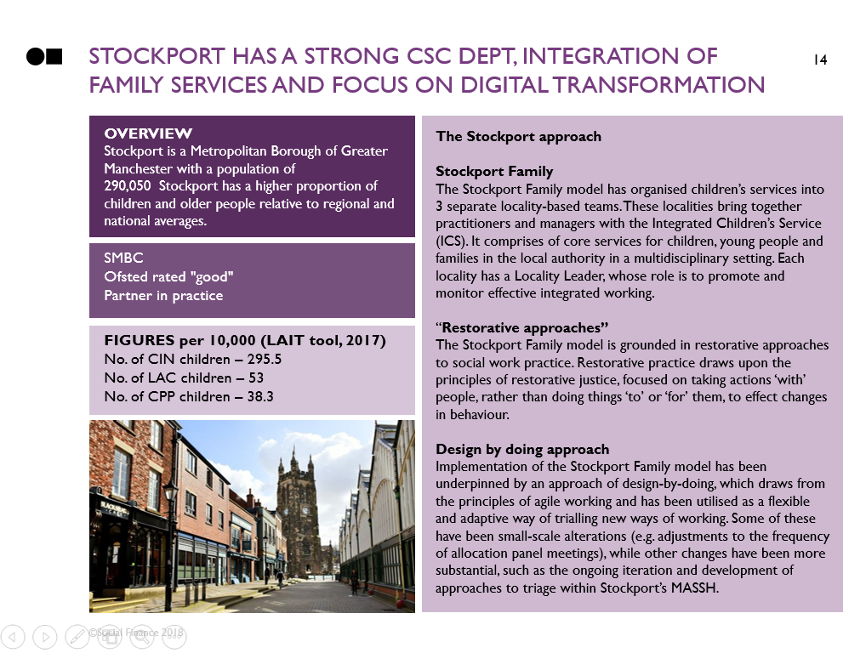
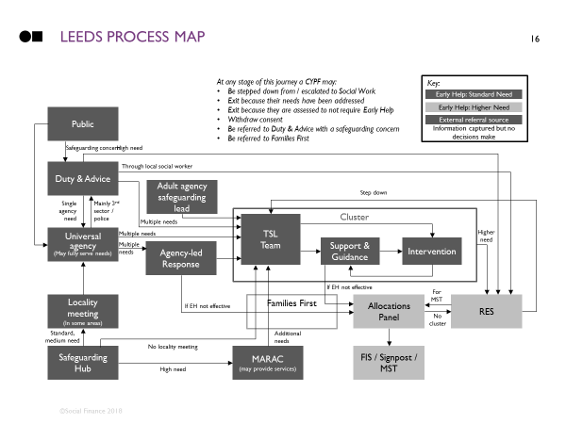
Initially we worked to understand the Stockport and leeds systems and approaches
1. We spoke to people to understand how Stockport and Leeds work
2. We used this to map out the services that families interact with

Slide 18





We spoke to a range of people across roles and services within Each council
Front Door Team
Social Worker
Early Help worker
Analyst
Leadership
We asked people….
Q1: What is your role and that of your team / service within the child and family system?
Q2: What are they key decisions you make about children and families?
Q3: What family information do you need that you currently don’t have?
Q4: What value would data about family context add when making these decisions?

Slide 19
In total We spoke to 62 people: 33 in leeds and 29 in Stockport
Leeds
Stockport
Name | Role
Clare Walker | Head of Digital Change
Peter Storrie | Head Children & Adults Intel. & Policy Serv.
Julie Longworth | Social Work Chief Officer
Nicola Palmer | Information Governance (IG) Lead
Luke Myers | Commissioner
Helen Stevens | Commissioner
Jude Roberts | Targeted Service Lead (TSL)
Keith Lander | Targeted Service Lead (TSL)
Amanda Bradley | Targeted Service Lead (TSL)
Simon Toyne | Targeted Service Lead (TSL)
Julia Pope | Targeted Service Lead (TSL)
Steve Lake | Targeted Service Lead (TSL)
Joanne Tomlinson | Targeted Service Lead (TSL)
Ben Brown | Families First Leadership
Ben Grey | Families First Leadership
Farrah Khan | Head of Front Door
Tracy Wylde | Intelligence Manager
David Jackson | Safer Leeds
Luci Caine | Intelligence Lead Analyst
Chris Hudson | Intelligence and Policy Business Analyst
David O’Connor | MDM & Systems & IG
Jean Ellison | Youth Work Lead
Andrea Richardson | Head of Service for EYs and Youth Work
Lisa Martin | Programme Performance Manager
Katie Craigmile | FF Leadership / Allocations Panel
Helen Binns | Front Door
Alison Szustakowski | Communities (Partner)
Mathew Brooke | CSWS REST
Dave Lawrence | Cluster SEMH
Chris Walker | Family Group Conferencing
Uzma Ahmed | Early Start Lead
Danielle Thomas | Social Worker
Lisa Swaine | Social Worker
Name | Role
Jeanette Warburton | Principal Lead - Integrated Services
Deborah Woodcock | Director of Operations, Stockport Family
Naveed Malik | Service Manager for IG
Steve Kilroy-Jolley | BI Developer
Laura Lovegrove | BI Analyst
Mark Murray | BI Development Manager
Craig Hughes | BI Service Manager
Dan Fenwick | BI Developer – Signpost
Maura Appleby | Principal Lead – Public Health
Joanne Harris | Operational Lead – MOSAIC
Sally Roy | Operational Lead – MASSH
Rebecca Key | Service Leader – Complex Safeguarding
Rachel Rollings | Locality Team Manager
Alby Atkinson | Digital By Design
Jacqui Bellfield-Smith | Service Leader – YOS/TYS
Katie Horridge | Service Leader MASSH & 1st Response
Jennie Neill | Service Leader Public Service Hub
Laura Pugh | Senior Practitioner (TAC)
Ann Marie Christie | Senior Practitioner (TAC)
Joyce Boyd | Team Leader School Age Plus (SAP)
Nicole Birchenall | Stockport Family Worker School Age Plus (SAP)
Nina Smith | Social Worker and Liquid Logic Project team
Megan Norwood | Senior Practitioner
Vincent Tracey | Locality Team Leader
John | Social Worker (ASYE)
Hayley Swift | Social Worker (student)
Jenna Roberts | Social Worker (ASYE)
Lizzie Dodd | Social Worker (student)
Matthew Purves | Social Worker

Slide 20
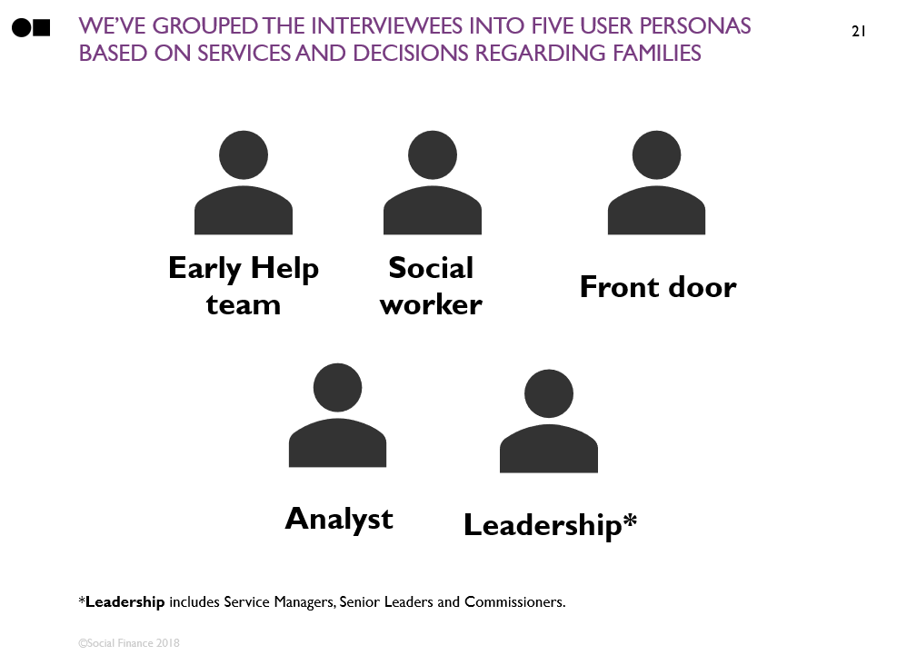
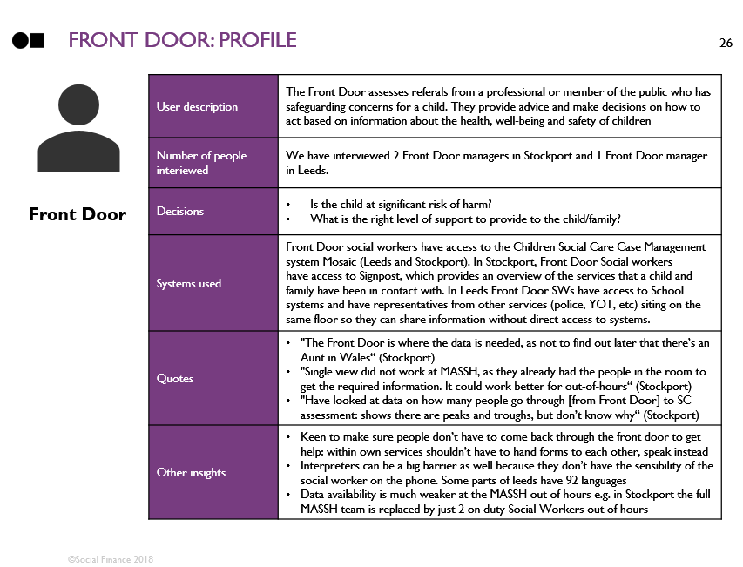
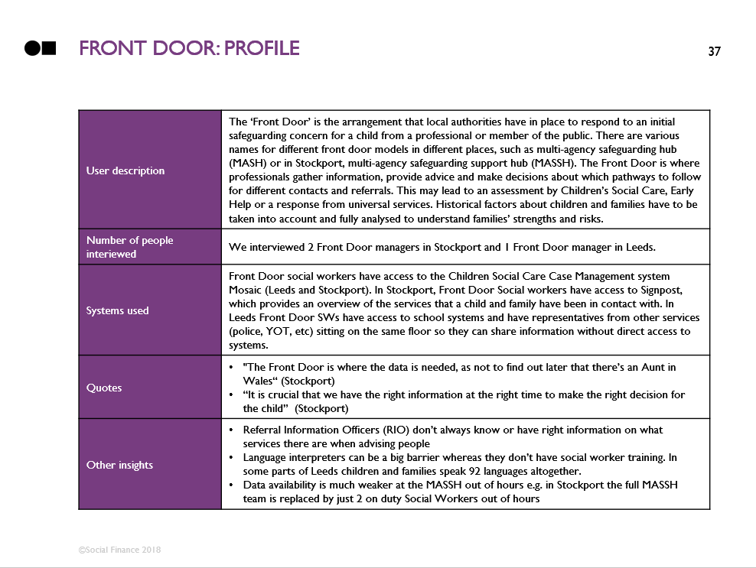
We focused on understanding their roles, workflow, decisions and needs
1. We grouped them into five personas
2. We wrote a profile for each
3. We mapped their workflow and decisions
4. We collected the needs they expressed

Slide 21
Secondly, we tested our findings and prioritised the user needs
1. Understanding needs – speak to users to understand their work, decisions, painpoints and needs
2. Testing and prioritisation – test findings with users and leadership and prioritise most important needs
3. Assessing options – explore potential approaches to meet the identified user need

Slide 22
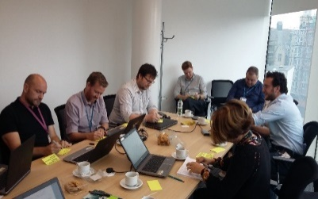
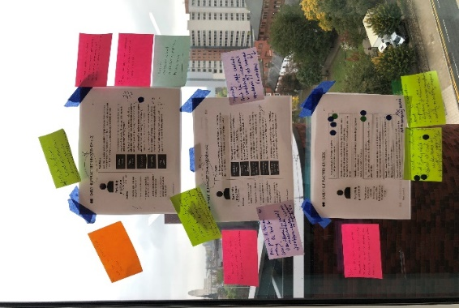
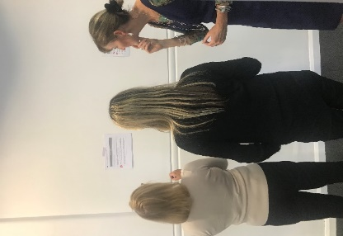
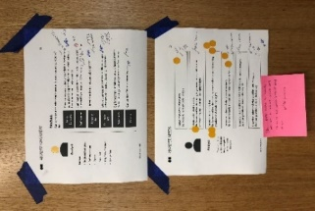
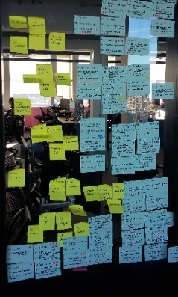
we took our findings back to people to test them and prioritise the most important user needs
To test and prioritise the longlist of user needs identified we:
Held Show and Tell workshops with the people we had interviewed
Tested findings with the Stockport and Leeds project team
Ran a survey with users
Conducted further interviews
Held a joint workshop with 8 authorities to test applicability elsewhere

Slide 23
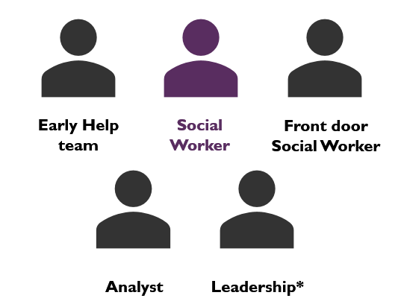
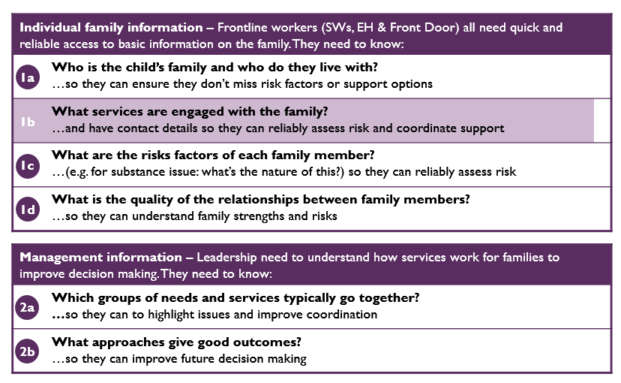
FROM THIS A SINGLE USER NEED EMERGED AS THE KEY PRIORITY: social workers NEED TO KNOW WHAT SERVICES ARE SUPPORTING A FAMILY AT THE POINT OF Social work assessment
User: Social Workers
Need: Know what services are supporting a family at the point of assessment

Slide 24
Thirdly, we explored potential options to meet this need
1. Understanding needs – speak to users to understand their work, decisions, painpoints and needs
2. Testing and prioritisation – test findings with users and leadership and prioritise most important needs
3. Assessing options – explore potential approaches to meet the identified user need

Slide 25
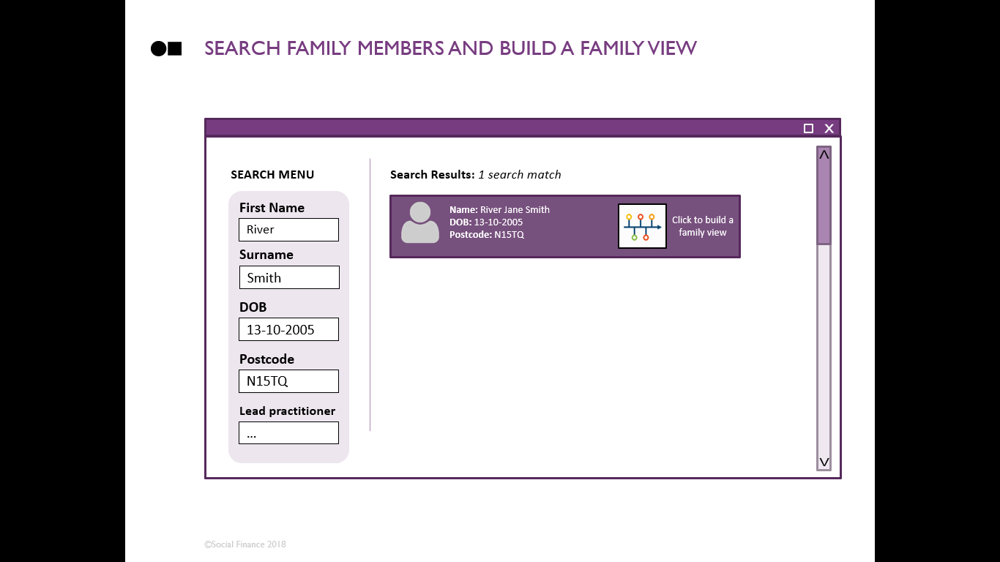
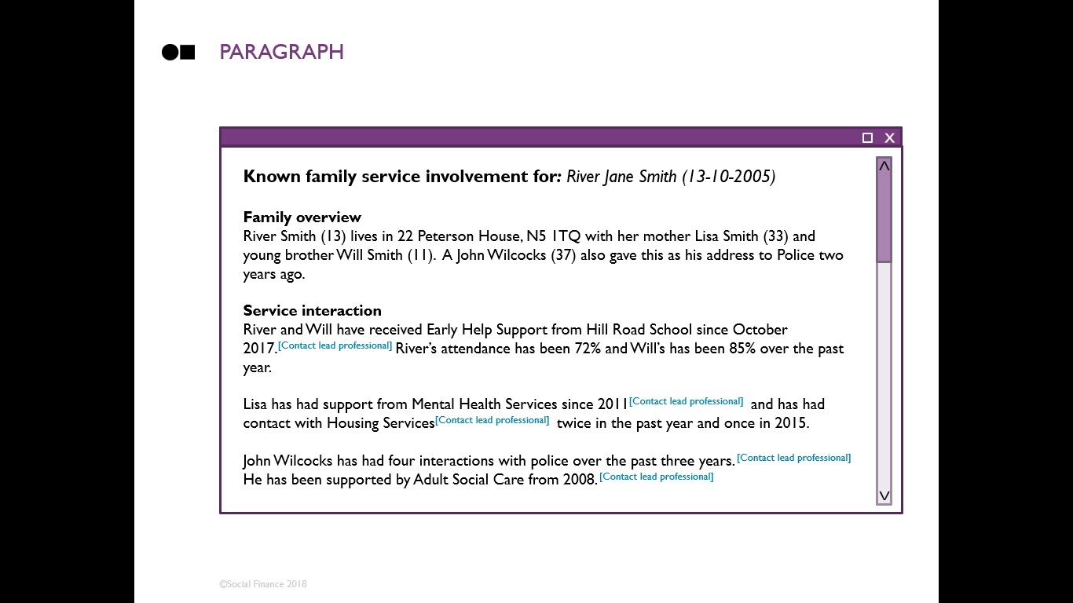
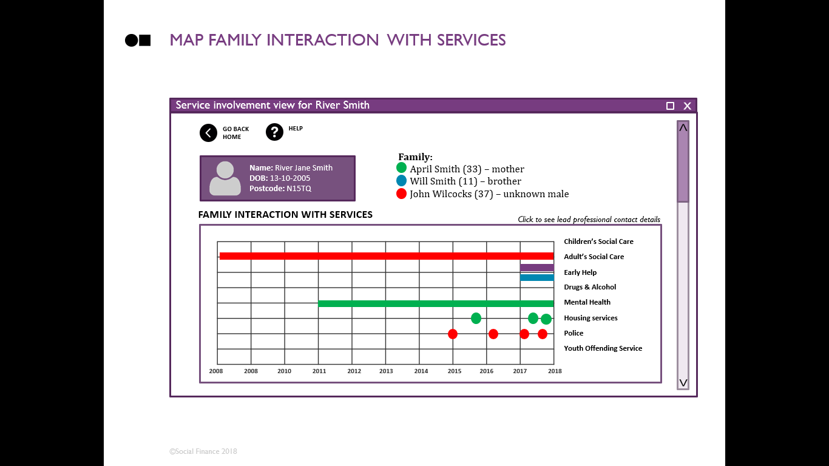
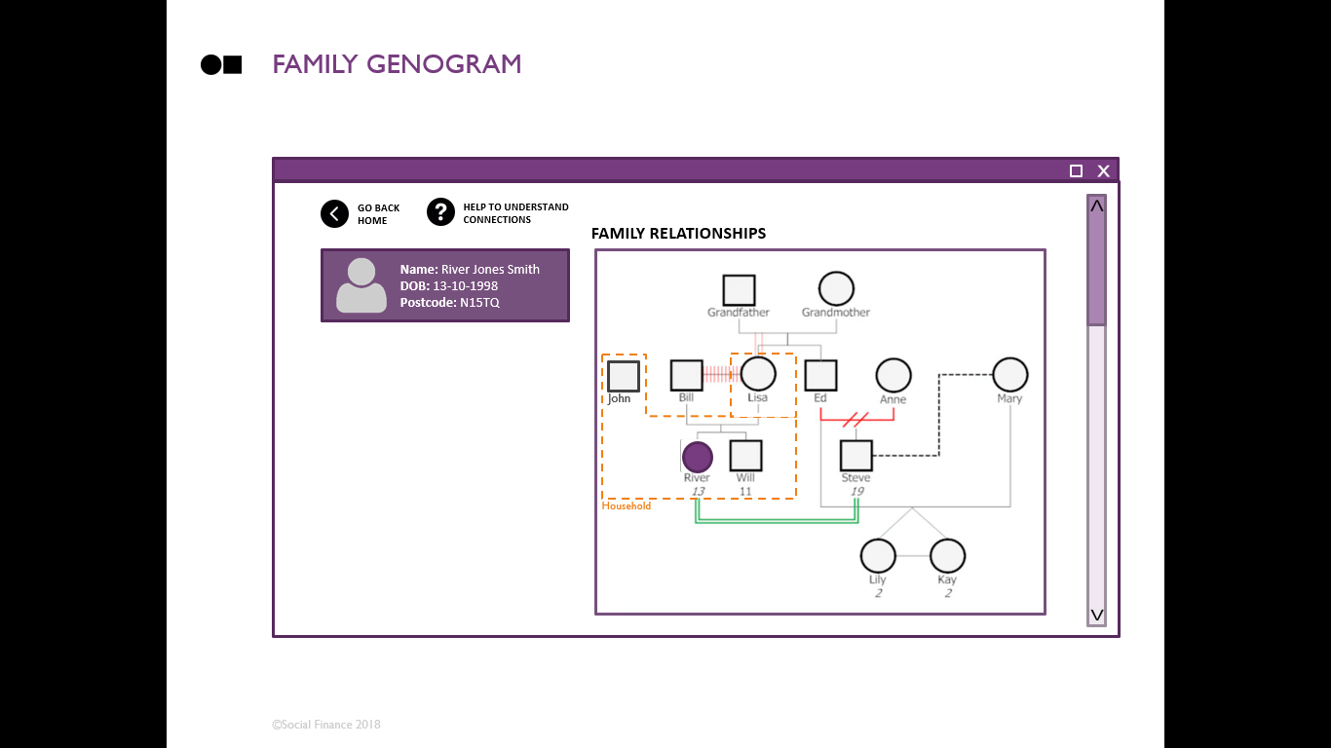
we created three mock-up potential tools and tested these with users to understand how they’d use them
Search page
Option 1 – text paragraph
Option 2 – family timeline
Option 3 – genogram

Slide 26
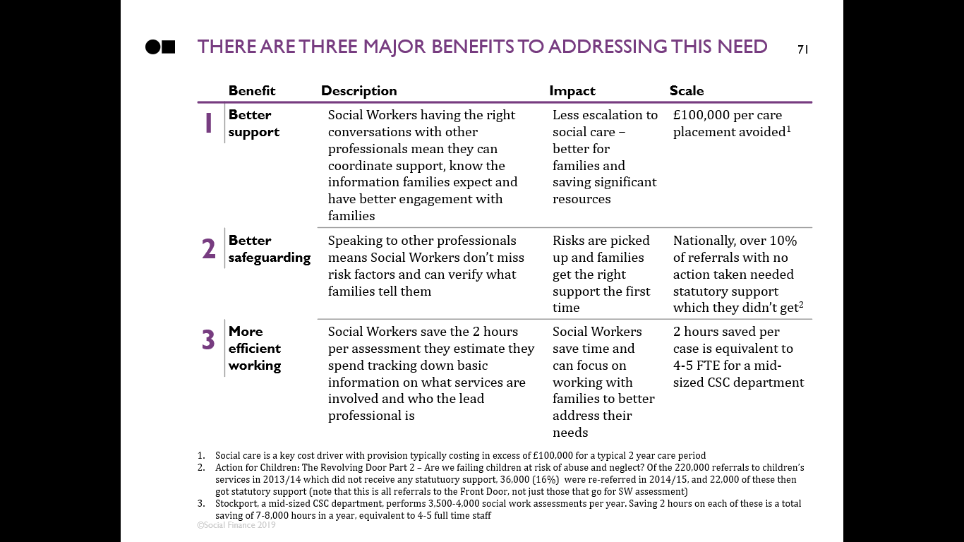
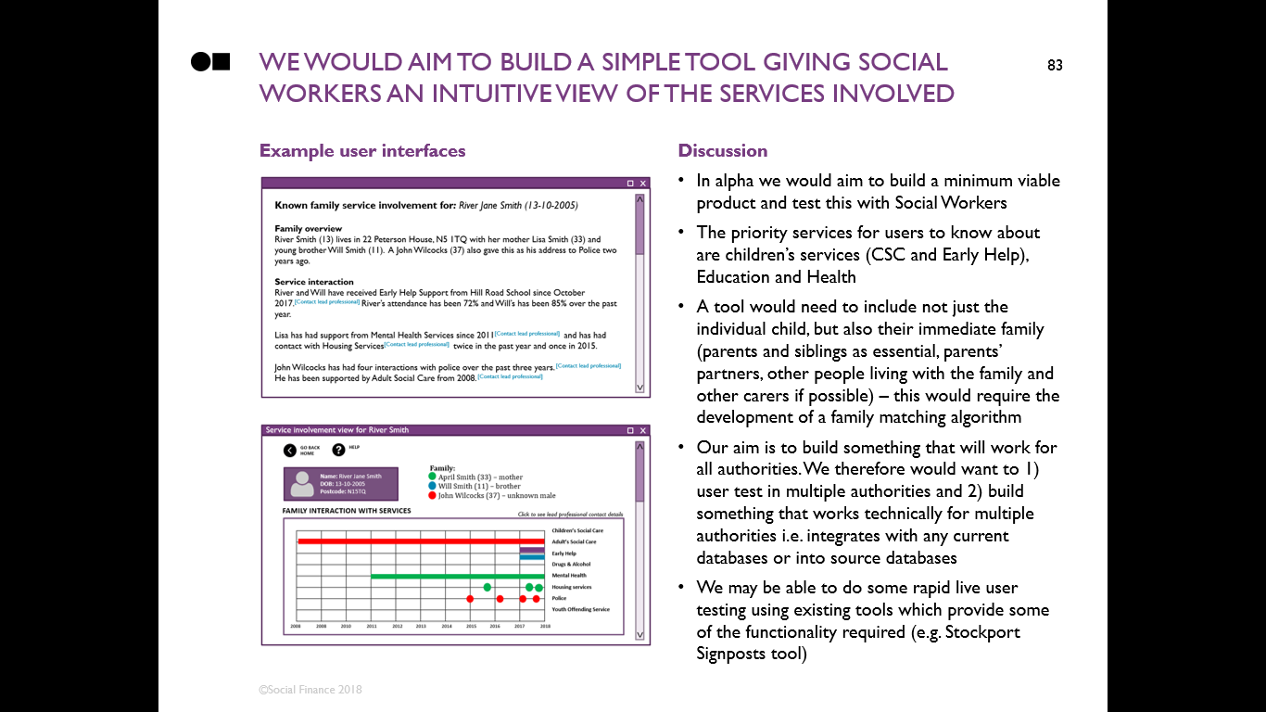
We analysed the business case for addressing the user need and how we could do this in alpha
Major benefits of addressing the need
What to build in alpha

Slide 27
CONTENTS
Introduction
Discovery process and methodology
Project deliverables
3.1. Leeds and Stockport specific context
3.2. User overview: needs, workflow and thematic analysis
3.3. Prioritised use case and user requirements
3.4. Business case
3.5. Existing solutions
3.6. User requirements testing
Next steps and plan for Alpha

Slide 28

stockport has a strong CSC dept, integration of family services and focus on digital transformation
Stockport overview
Stockport is a Metropolitan Borough of Greater Manchester with a population of 290,000
Stockport has a strong children’s services department (rated ‘good’) and is a DfE partner in practice
Stockport uses transformation to improve services, particularly through use of digital
Figures per 10,000 (LAIT tool, 2017)
No. of CIN children – 296
No. of LAC children – 53
No. of CPP children – 38
The Stockport approach – key features
Stockport Family
The Stockport Family model combines core services for children, young people and families (children’s services, education and health) together to give coordinated multi-agency support to children and families. These services are split geographically into three locality teams. For example bringing together a “team around the child” or “team around the school” to give holistic support
“Restorative approaches”
The Stockport Family model is grounded in restorative approaches to social work practice. Restorative practice draws upon the principles of restorative justice, focused on taking actions ‘with’ people, rather than doing things ‘to’ or ‘for’ them, to effect changes in behaviour
Digital by design approach
Implementation of the Stockport Family model has been underpinned by an approach of digital by design, which draws from the principles of agile working and has been utilised as a flexible and adaptive way of trialling new ways of working. Some of these have been small-scale alterations (e.g. adjustments to the frequency of allocation panel meetings), while other changes have been more substantial, such as the ongoing iteration and development of approaches to triage within Stockport’s MASSH

Slide 29

leeds is a far larger council, also with a strong and innovative CSC dept. underpinned by digital innovation
Leeds overview
Situated in West Yorkshire, with a diverse population of 783,000, Leeds one of the largest and fastest growing cities in the UK
Leeds has a strong children’s services department (rated ‘outstanding’), focussing on worth “with” families and is a DfE partner in practice. It also focusses on improvement through digital
Figures per 10,000 (LAIT tool, 2017)
No. of CIN children – 369
No. of LAC children – 76
No. of CPP children – 31
The Leeds approach – key features
“Right conversations, right people, right time”
Leeds recognises that continual assessment supported by conversations is the best way of identifying and responding to the needs of children and young people
“Think Family, Work Family”
Leeds has been working hard to improve joined up working for children, young people and families over recent years. Leeds’s “Think Family, Work Family” means recognising and responding to the needs of all family members in a holistic approach, by communicating with other practitioners working with the family and coordinating your efforts for the best outcomes
Family Group Conferencing (FGCs)
Leeds has pioneered FGCs, which are voluntary decision-making meetings to help families find their own solutions to problems. “The wide use of FGCs has led to an increase in children who are placed within their extended family.” (2015 Ofsted report)
Cluster working
Given the size of the city, Leeds has organised its Children’s Services across twenty-five local clusters. These Clusters bring together managers from a range of universal, targeted and specialist children’s services in each local area, including schools, children’s centres, police, social work, the third sector, etc.

Slide 30
There are a range of services and agencies that support children and families in leeds and Stockport
Service type
Description
Example agencies in Leeds
Example agencies in Stockport
Universal
Available to all children / families
Some are compulsory (e.g. schools, health visitors), some are targeted at higher needs but still open-to-all (e.g. Youth Services)
Schools
Universal Children’s Centre services
Youth Services (usually community centre funded)
Health Visitor Team
Schools
Universal Children’s Centre Services
Youth Services
Health Visitor Team
Universal Plus
Activity focused on individuals with additional need
Requires consent
Ranges from informal, to enrolled sessions to courses
Youth Provision
Children’s Centre Services
Cluster teams (EH)
School pastoral / family support
Targeted Early Years places
Early Years
Youth Provision
Children’s Centre Services
School Nurses
EH (Early Help)Team
Targeted
Support targeted to specific individuals and involving assessment, plan, review and a lead practitioner
Requires consent
Can be both multi & single agency
Children’s Centre Services
RES teams
Cluster teams
Family Support teams
Targeted Youth Support
Area Inclusion Partnerships
Targeted Youth Support
Family Nurse Partnership (FNP)
Education Welfare Team
Stockport Family NEET Team
Stockport Family Carers and Transition Team
Increasing level of need
Specialist & higher needs targeted Interventions
Non statutory specialist support for those with higher needs
Requires consent
Source of referral (or who holds the case) determines if case is considered specialist or targeted
MST
Family Intervention Services / RES Team support
Signpost
Family Group Conferencing
Children with Disabilities Teams
MOSAIC (drugs and alcohol service)
Family Group Conferencing
Statutory Services
Services for high need individuals that councils must legally provide
Children’s Social Care Teams
Youth Offending Service
CAMHS
SILCs incl SEMH provision
Children’s Social Care Teams
Youth Offending Service
Young Carers Service
Healthy Young Minds (HYMs)

Slide 31
Leeds process map
Key:
At any stage of this journey a CYPF may:
Be stepped down from / escalated to Social Work
Exit because their needs have been addressed
Exit because they are assessed to not require support
Withdraw consent
Be referred to Duty & Advice with a safeguarding concern
Be referred to Families First
Early Help: Standard Need
Early Help: Higher Need
Social Care
Public
External referral source
Information captured but no decisions made
Safeguarding concern
High need
Duty & Advice
Through local social worker
Adult agency safeguarding lead
Step down
Single agency need
Mainly 3rd sector / police
Cluster
Multiple needs
TSL
Team
Universal agency
(May fully serve needs)
Multiple needs
Higher need
Multiple needs
Agency-led Response
Support & Guidance
Intervention
If EH not effective
Locality meeting
(In some areas)
Families First
Allocations Panel
For MST
RES
If EH not effective
No cluster
Standard, medium need
Additional needs
Safeguarding Hub
No locality meeting
MARAC
(may provide services)
FIS / Signpost / MST
High need
Social Care

Slide 32
Stockport process map
At any stage of this journey a CYPF may:
Exit because their needs have been addressed
Exit because they are assessed to not require Early Help or statutory support
Withdraw consent (if below statutory thresholds)
Professionals
Public
SAFEGUARDING
Services
MASE
(CSC panel)
Legal process
Safeguarding concern
Child Protection Section 47
MASSH
MFH
(Missing from home)
IRO
TAC
(Team Around Child)
Step down
Complex Safeguarding
First Response
EH Hub
Step up
Multiple needs
Locality
Team
Aspire
Team
Single agency need
Mainly 3rd sector / police
EH Team
Universal agency
(May fully serve needs)
Advice & Info
Multiple needs
If TAC not effective
TAS
(Team Around School)
ICPC
Strategy Meeting
SPECIALIST SERVICES
CWD
(Children with disabilities)
PLO
LPM/LGM
YOS (Youth offending services)
EXTERNAL PANELS
Care Proceedings
LOCAL PANEL
MARAC
(All ages)
MAPPA
(18+)
MAARS
(Multi-agency adult risk of safeguarding) (18+)
MOSAIC
(Drug and alcohol services)
Chaired by GMP
Chaired by Probation
Any professional can refer on basis of risk
Stockport Family staff may attend and contribute

Slide 33
CONTENTS
Introduction
Discovery process and methodology
Project deliverables
3.1. Leeds and Stockport specific context
3.2. User overview: needs, workflow and thematic analysis
3.3. Prioritised use case and user requirements
3.4. Business case
3.5. Existing solutions
3.6. User requirements testing
Next steps and plan for Alpha

Slide 34

We’ve grouped the interviewees into five user personas based on services and decisions regarding families
Early Help worker
Social Worker
Front door Social Worker
Analyst
Leadership*
*Leadership includes Service Managers, Senior Leaders and Commissioners

Slide 35
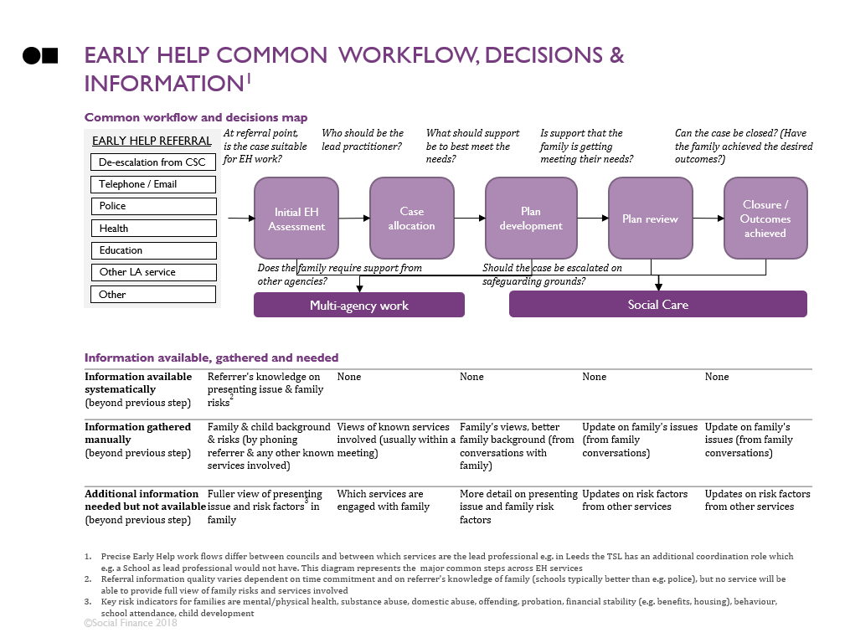
The following slides give a profile, workflow, decision & information map, and user needs for each user
Slide | Title | Description
 | User profile | Overview of each persona, their roles, the systems they use, how many people we spoke to and key overall quotes and findings
 | Workflow, decisions and information map | Summary of the common work processes this user takes with children/families, what decisions they make, what information they have and what they are missing (only for frontline services who work directly with families)
 | User needs | The key needs that emerged for this user persona from our interviews We tested these needs with users in show and tell workshops and have marked the needs that users prioritised as most important with stars:
= prioritised by users in Leeds = prioritised by users in Stockport

Slide 36
Front Door Social workers

Slide 37
Front door: profile
User description | The ‘Front Door’ is the arrangement that local authorities have in place to respond to an initial safeguarding concern for a child from a professional or member of the public. The Front Door can be organised as a multi-agency safeguarding hub (MASH) or in Stockport, multi-agency safeguarding and support hub (MASSH). The Front Door is where professionals gather information, provide advice and make decisions about which pathways to follow for different contacts and referrals. It includes Social Workers and team managers.This may lead to an assessment by Children’s Social Care, Early Help or a response from universal services. Historical factors about children and families have to be taken into account and fully analysed to understand families’ strengths and risks.
Number of people interviewed | We interviewed 2 Front Door Social Work (SW) managers in Stockport and 2 in Leeds
Systems used | Front Door SWs (Social Workers) have access to the Children Social Care Case Management system (Mosaic in Leeds and EIS in Stockport). In Stockport, Front Door Social workers have access to Signpost, which provides an overview of the services that a child and family have been in contact with. In Leeds Front Door SWs have access to school systems. Both councils have a multi-agency set up with representatives from other services (police, YOT, etc) sitting on the same floor so they can share information without direct access to systems
Quotes | "The Front Door is where the data is needed, so we don’t find out later that there’s an Aunt in Wales“ (Stockport) “It is crucial that we have the right information at the right time to make the right decision for the child” (Stockport) "Out of hours need more information as they have limited access to systems" (Stockport)
Other insights | Referral Information Officers (RIO) don’t always know or have right information on what services there are when advising people Language interpreters can be a big barrier as they don’t have social worker training. Across Leeds, for example, children and families speak 92 languages altogether Data availability is much weaker at the MASSH out of hours e.g. in Stockport the full MASSH team is replaced by just 2 on duty Social Workers out of hours

Slide 38
Front door workflow, decisions & information¹
Section 47 – strategy meeting
Is the child at immediate risk of harm?
1
2
3
4
Safeguarding Referral
First Response Triage
Contact the family
Checks with other agencies
Decision and Recommendation
Propose pathway decision
Close Referral
Manager agrees proposed pathway decision
SW actions closure
By telephone / email:
Advice and guidance
Common workflow
Police
Referral to EH
Health
Education
Referral for SW assessment
Other LA service
Other
Decision map
Is a SW involvement needed?
What is the right level of support to provide to the child/family?
Does the recommendation meet the presenting needs?
Information available systematically (beyond previous step) | Referrer's knowledge on presenting issue & family risks² | None | None | Information gathered from triage passed on appropriately
Information gathered manually (beyond previous step) | Family & child background & risks (by phoning referrer & any other known services involved) | Details of services involved with the child and family, e.g. contact details, period of involvement Family's views, better family background (from conversations with family) | None | None
Additional information needed but not available (beyond previous step) | Which services are engaged with family Fuller view of presenting issue and risk factors in family | More detail on presenting issue and family risk factors
Information available, gathered and needed
1. Front Door work flows differ between councils e.g. in Stockport the Early Help Hub sits in the Front to make decisions on EH referrals passed from MASH. This diagram represents the common steps across the Front Door workflow.
2. Key risk indicators for families are mental/physical health, substance abuse, domestic abuse, offending, probation, financial stability (e.g. benefits, housing), behaviour, school attendance, child development

Slide 39
Front door: user needs
Workflow | User needs | Detail | Decision and information needed | P
Phase 2: First Response Triage | At initial point of triage, access to information on the child and their family (e.g. risks and strengths of the family) is needed to inform decision making Having the relevant data around families in one place to make more timely assessment of risk and recommendations | There is a lack of historical factors about the family to understand the context in which children are living, including both risks and protective factors Collating relevant evidence on families is not always efficient, quick and as easy as possible – largely because of the different systems that holds information and access rights | Decisions: Is a SW assessment needed? Is the child at risk of significant harm? Information required: Family & child background & risks Which services are engaged with family Details of services involved with the child and family, e.g. contact details, period of involvement
Phase 1: Safeguarding referral | At point of referral, good quality basic information is required to avoid spending time chasing information | Lack of basic initial information on referral form, e.g. not having the parent’s telephone number on the referral form to make initial contact | Decisions: Is a SW assessment needed? Is the child at risk of significant harm? Information required: Basic information on family members
Phase 3: Decision and Recommendation | To conclude triage, understanding the family perspective and needs is key to the decision made To identify the most appropriate support, we need to understand the local offer within the area | Lack of family engagement at time of referral can mean initial information about the safeguarding concern misses out the family perspective There can be a lack of up-to-date information on what is available within the area | Decisions: What is the right level of support to provide to the child/family? Information required: Family’s view Real-time information on services available in the area
= prioritised by users in Leeds = prioritised by users in Stockport

Slide 40
Social workers

Slide 41
Social worker: profile
User description | Social Workers support individual children and families with more severe needs or safeguarding risk. Their role is to help improve outcomes for children and families by providing both challenge and support Social Workers perform the statutory duty of the Local Authority (LA) to ensure children are safeguarded. This means that a number of their processes are legally specified e.g. those around assessments for Children in Need, those on Child Protection Plans and Looked After Children. They must perform timely assessments to ensure that vulnerable people are safeguarded from harm In Leeds, Social Workers generally specialise in a certain type of support. In Stockport, Social Workers are more general but will follow a family throughout their journey e.g. from being a Child in Need, through escalations and to legal proceedings Social workers work typically work collaboratively with other professionals, for example bringing together and co-ordinating the “team around the child” in a multi-disciplinary approach to safeguarding
Number of people interviewed | We interviewed 14 social workers across the two councils, as well as speaking to leadership on the challenges and support for social workers. This was split as 3 social workers in Leeds and 11 social workers in Stockport (a mixture of team leaders, senior practitioners and “Team Around the Child” coordinators)
Systems used | Social workers have access to the CSC Case Management system (Leeds – Mosaic, Stockport – EIS). Note that Front Door Social Workers have access to Signpost (in Stockport) and have other indirect access to systems (through professionals from other services at the MASSH) whereas other social workers don’t
Quotes | “Sometimes there’s not enough info on families and it’s your job to update it” (Leeds) “Recording reduces SWs sense of autonomy or of skill. Just churning things through a machine” (Stockport) “Conversations are quicker and easier” “Let’s stop thinking we should digitise everything” (Stockport) “We spend more time writing notes than working with families. I try to prioritise my families but overall spend 50-75% of time on paper work and court work” (Leeds) Social workers have to "wade through documents and documents and documents" to get the information they need (Stockport)
Other insights | Caseloads and referral volumes are viewed as too high and hindering practice

Slide 42
Social Worker workflow, decisions & information¹²
1
2
3
4
5
Referral
Receive Referral
Check what is on the system
Contact referrer
SW Assessment
Contact with the family
Get info from other professional
Plan development
Initial TAF/TAC meeting
Output could be to deliver 6-8 focussed intervention sessions
Review Plan
Review TAF/TAC meeting every 6 weeks
MASH / Front Door
Escalate to CP/LAC
Common workflow
Early Help
Further CIN/TAC support required
Specialist Services
Closure/step down to EH -outcomes achieved
Other
How quickly do I need to see the child?
Do I need to see the child today?
Does the family require support from other agencies?
Is there a safeguarding issue? Should we escalate or de-escalate the case?
Is the family ready for FGC?
Does the parent(s) have the capacity to meet the child’s needs?
Is there a safeguarding issue? Should we escalate or de-escalate the case?
Does the family need further support?
Can the case be closed? Have the family achieved the desired outcomes?
Does the family need further support?
Can the case be closed? Have the family achieved the desired outcomes?
Decision map
Information available systematically (beyond previous step) | Information from MASH triage Referrer's knowledge on presenting issue and family risks³ | Information from liaising with other agencies involved | None | None
Information gathered manually (beyond previous step) | Family and child background and risks (by phoning referrer and any other known services involved) | Views of known services involved Family's views, better family background (from conversations with family) | Updates on intervention plan from other services Update on family's issues (from family conversations) | Updates on risk factors from other services Update on family's issues (from family conversations)
Additional information needed but not available (beyond previous step) | Which services are engaged with family Fuller view of presenting issue and risk factors⁴ in family | More detail on presenting issue and family risk factors | Updates on risk factors from other services
Information available, gathered and needed
1. The workflow reflects the specifics of a CIN Social Worker – steps #1-3 would be common across a child’s level of nee, but from #4 onward these would differ based on child status
2. This diagram represents the major common steps across Children Social Care Teams following receipt of a referral from MASH. In Stockport TAC (tier 3) is equivalent to the CIN section 17 process
3. Referral information quality varies dependent on time commitment and on referrer’s knowledge of family (schools typically better than e.g. police), but no service will be able to provide full view of family risks and services involved
4. Key risk indicators for families are mental/physical health, substance abuse, domestic abuse, offending, probation, financial stability (e.g. benefits, housing), behaviour, school attendance, child development

Slide 43
Social worker: user needs (1/2)
Workflow | User needs | Detail | Decision and information needed | P
Phase 2: Receive referral | At point of referral, understanding family relationships, including strengths and needs to assess potential risks Knowing what services are involved with family to understand the family and coordinate support | Linking family members, depends on manual inputting from SWs and provides limited understanding of relationships Limited access to systems means discovering what services are involved requires "detective work" | How quickly do I need to see the child? Is there safeguarding issue? Should we escalate or de-escalate the case? Information required: Which services are engaged with family Fuller view of presenting issue and risk factors in family Views of known services involved
Phase 3: SW Assessment | Knowing about family issues on mental health, drugs, alcohol and involvement with police can better inform decisions about placement / care | Case Management Systems (CMSs) only include information on other service involvement where a Social Worker has been aware of it previously (this information can also be out of date) | Does the family require support from other agencies? What services are required to best support the family? Information required: Views of known services involved
Phase 3: SW Assessment | When families move into LA, knowing their past CSC history to inform current assessment | SWs waste considerable time having to travel to other Local Authorities to access past data on families – this can be several hundred miles | Is there safeguarding issue? Should we escalate or de-escalate the case? What services are required to best support the family? Information required: Views of previous services involved
Phase 4: Plan development | Understanding the local offer within the area to identify the most appropriate support | Lack of up-to-date information on what is available within the area | What services are required to best support the family? Information required: Family’s view Real-time information on services available in the area
= prioritised by users in Leeds = prioritised by users in Stockport

Slide 44
Social worker: user needs (2/2)
Workflow | User needs | Detail | P
Phase 4 & Phase 5 | I need: to save time entering data (e.g. writing up case notes) So I can: focus on family | SWs spend a lot of time recording cases notes (e.g. uploading text messages from families into Mosaic)
Phase 2 & Phase 3 | I need: to be able to pin point key information from case files So I can: build up a picture of a situation quickly to summarise previous interventions, risk and protective factors | Case files consist of very long and detailed notes making it difficult to identify key information to compile chronologies, assessments etc.
Phase 3: SW Assessment | I need to: understand what works for the family So I can: avoid repeating any mistakes made in previous plans | Data presented on systems often doesn’t fully translate the experience of the family. SWs want to improve their engagement with families, especially those who may have previously been in CSC
Phase 5: Review Plan | I need: to understand how my decisions link to children and family outcomes So I can: know more about what went well and what works for families achieving positive outcomes | SWs have low levels of understanding of how decisions and support link to children and family outcomes. E.g. don’t know what happens on de-escalation, some assessments such as parenting capacity have no standard approach and are quite subjective

Slide 45
Early Help workers

Slide 46
Early Help worker: profile
User description | Early Help services work with children, young people and families where there are indicators of emerging difficulties or additional needs. They aim to address these needs at an early stage, before they progress to being more serious concerns (e.g. before children’s services is required) Needs can include anything affecting health, development, wellbeing and safety of children and young people EH is typically delivered collaboratively between services. However it can also be delivered by a single agency (e.g. schools, children centres, health visitors, third sector agencies etc). EH is typically coordinated by a specialist, who may also deliver some support. In Leeds these are “Targeted Service Leads” (TSLs) and their teams. In Stockport it is “School Age+ workers” & SWs linked to schools
Number of people interiewed | We interviewed 9 people from EH:1 School Age+ (EH) worker and 1 School Age+ (EH) Team Leader in Stockport and 7 TSLs in Leeds
Systems used | In Leeds TSLs’ teams mainly use Mosaic and Cluster spreadsheets as their CMS. EH practitioners in Children Centres and schools have access to their systems. Stockport EH Teams use EIS (Children’s Services CMS)
General quotes | “I have created a chronology of the child to build the case. When doing that I rang Croydon to complete the picture but they said no so I had to drive there to actually understand what happened to the child before she moved to Leeds” (Leeds) "I didn't know the parent was seeing a counsellor". "You don't know if the parents are working well with the job centre unless they tell you" (Stockport) "Often referrals don’t have family context information included, despite the fact that there is space on the form to do that." (Leeds) "We get police data on crimes involving children the previous day but it's too hard to stay on top of this“ (Leeds) "One extra piece of information sometimes enabled life-saving intervention" (Leeds) "One piece of information I would like is who’s living in the household. I don’t always know who the housing officer is, and if I do then they don’t always know either” (Stockport)
Other insights | Some workers view was that EH decisions aren’t always robust enough. Development or challenging behaviour concerns at age 2-3 can be picked up, with an EH assessment needed at this point Leeds used to identify top100 children at risk, but the workload involved was too major to sustain EH workers rely on parents, schools etc. to inform them of changes in the family's situation. This means they can miss changes in the family’s situation

Slide 47
Early help common workflow, decisions & information¹
Common workflow and decisions map
1. Early Help Referral
Multi-agency work
Social Care
By telephone / email:
Does the family require support from other agencies?
Should the case be escalated on safeguarding grounds?
De-escalation from CSC
Police
2. Initial EH Assessment
Contact with the family
Get info from other professional
3. Plan development
Initial TAF/TAC meeting
Output could be to deliver 6-8 focussed intervention sessions
4. Review plan
Review TAF/TAC meeting every 6 weeks
Escalate to CSC
Health
Further TAC support required
Education
Other LA service
Closure - Outcomes achieved
Other
At referral point, is the case suitable for EH work?
Who should be the lead practitioner?
Is the support the family are getting meeting their needs?
Does the family need further support?
What should support be to best meet the needs?
Can the case be closed? Have the family achieved the desired outcomes?
Information available, gathered and needed
Information available systematically (beyond previous step) | Referrer's knowledge on presenting issue & family risks² | None | None | None
Information gathered manually (beyond previous step) | Family & child background & risks (by phoning referrer & any other known services involved) | Views of known services involved Family's views, better family background (from conversations with family) | Update on family's issues (from family conversations) | Update on family's issues (from family conversations)
Additional information needed but not available (beyond previous step) | Which services are engaged with family Fuller view of presenting issue and risk factors³ in family | More detail on presenting issue and family risk factors | Updates on risk factors from other services | Updates on risk factors from other services
Early Help work flows differ between councils and between which services are the lead professional. In Leeds, the TSL has an additional coordination role which, for example, a school as lead professional would not have. This diagram represents the major common steps across EH services
Referral information quality varies dependent on time commitment and on referrer’s knowledge of the family (schools typically better than e.g. police), but no service will be able to provide full view of family risks and services involved
Key risk indicators for families are mental/physical health, substance abuse, domestic abuse, offending, probation, financial stability (e.g. benefits, housing), behaviour, school attendance, child development

Slide 48
Early help worker: user needs (1/2)
Workflow phase | User needs | Detail behind user need | Decision and information needed | P
Phase 3: Plan Development | Knowing about family issues regarding mental health, drugs, alcohol and involvement with police can better inform me as to the level of support the family needs Knowing what services are involved with the family to understand the family and coordinate support | There is no way EH workers can guarantee they know about all services engaged with the family and the interventions received Most EH workers lack access to information from other services in any systematic way. They have to investigate to find out what services are involved with the family and then collect information from these services | At referral point, is the case suitable for EH work? Does the family require support from other agencies? Information required: Family & child background & risks Which services are engaged with family At plan development stage, who should be the lead professional? What should support be to best meet the needs? Information required: Views of known services involved
Phase 3: Plan Development | Knowing when a child and family’s situation changes (e.g. move house, parents divorce etc.) to assess changes in risk level | EH workers rely on parents or schools (if they know) to update them on changes in family situation, meaning they can miss important changes | Is support that the family is getting meeting their needs? Information required: Update on family's issues (from family conversations)
Phase 3: Plan Development | When families move into LA, knowing their past CSC history to inform current assessment | EH workers sometimes have to physically drive to other Local Authorities to access information on families that move | Is support that the family is getting meeting their needs? Information required: Updates on risk factors from other services
= prioritised by users in Leeds = prioritised by users in Stockport

Slide 49
Early help worker: user needs (2/2)
Workflow phase | User needs | Detail | P
Phase 2: Initial EH Assessment | I need: to understand what EH is defined as and understood by other agencies So I can: be clear with other agencies on when I need to be involved | There is cno consistent definition of EH currently, leading to misunderstanding and inappropriate referrals
Phase 1: Early Help Referral | I need: good quality information on referral So I can: spend less time chasing info | Quality and level of detail of referral forms varies a lot depending on referees (e.g. information on a referral can be as simple as a line of text or as detailed as one or two text pages)
= prioritised by users in Leeds = prioritised by users in Stockport

Slide 50
Analyst

Slide 51
Analyst: profile
User description | Analysts provide all roles with the data and insight required to make good decisions. The Analyst user covers Insight and Intelligence analysts, Business Intelligence analysts, Performance analysts, Cluster analysts, Safer Leeds, Early Start analysts and Troubled Families team. The type of reporting and cadence varies depending on the specific service / team they are attached to (e.g. an Analyst within the Intelligence and Performance team in Leeds would run quarterly reports for Mid-Managers on service performance - Safeguarding (LAC, CIN, CPP), Specialist (CwCN, YOS) & Targeted (EH).
Number of people interiewed | We have interviewed 6 Analysts in Leeds and 6 in Stockport
Decisions | Analysts support other decision makers providing data and insights, but do not make decisions on children or families themselves. However they do need to understand families in order to produce the insight required. At the moment most of the reports and analysis focus on individuals (e.g. reports on vulnerable children and adults) and ideally they would like to be able to report on families.
Systems used | In Leeds the systems Analysts have access to various systems across services. In Leeds, the Intelligence and Performance team have access to Mosaic, synergy, Child View (YOS), insight outreach (NEET). Safer Leeds have access to Police data and some other specific data as needed. The Families First (Troubled Families) team has access to Mosaic, Synergy, Child View (YOS) and Police data. In Stockport, Analysts have access to the Children's Warehouse which includes EIS and Synergy (schools) and some access to Child View (YOS) and the drug and alcohol service system
Quotes | “When I find an error in the data, there is no way I can go back to the system and make sure it is propagated across systems where it is recorded.” (Leeds) “When something changes within the family context, the data only reflects when there is an episode.” (Leeds) “Some things are difficult because of structure of data or access levels.” (Stockport) “I can’t get a view of family groups.” (Stockport)

Slide 52
Analyst: user needs
Theme | User needs | Detail | P
Access to data | I need: better access to data So I can: spend less time trying to access data and focus on understanding the population and developing insights | There is limited data sharing between public agencies. Often access to data relies on personal connections with other services
 | I need to: understand who is part of the family So I can: link family members and create reports on families | Most systems record data on individual level and only some allow linking to family members, this makes it harder to understand family dynamics
 | I need to: be able to identify children and families across different systems So I can: track journeys and perform longitudinal analysis | Different systems use different identifiers making it difficult for analysts to track people across systems. There isn’t one unique identifier across services
Data quality | I need: better quality data So I can: spend less time checking errors and focus on understanding population and developing insights | Data quality is often an issue in Analyst’s day to day work, e.g. some people use false names or different surnames with different agencies, or data entry includes errors
Other | I need: more time and resources So I can: do more and better analysis | Analysts feel they don’t always have the time and resources to perform the analysis required (e.g. little time to invest in more complex analysis and limited capabilities in terms of matching data sets)
 | I need: to understand what would be useful to report So I can: provide the info in the best way | Analysts often feel there is no clear guidance on what leadership needs to see in reports
= prioritised by users in Leeds = prioritised by users in Stockport

Slide 53
Leadership

Slide 54
Management & leadership: profile
User description | Senior leaders are responsible for the performance of services and systems, including safeguarding and commissioning services and have ultimate responsibility for safeguarding
Number of people interiewed | 3 Team Leader/Managers, 2 Operational Leads and 6 Senior Leaders were interviewed in Stockport. 9 Service / Programme managers and 2 Commissioners were interviewed in Leeds
Decisions | Which populations should be prioritised? What should be the offer for those populations? What services should be commissioned? What can be done to help commissioned services delivering better outcomes for children and families?
Systems used | In Stockport, Management and Leadership have access to EIS, Signpost and Tableau dashboards built on the Children's Warehouse (MDM with EIS & Synergy schools data). Senior Leaders regularly use this for wider case management to get an overview of a case, e.g. quick access of information on an individual family when on a review panel In Leeds management have access to Mosaic as well as some dashboards (e.g.. excel-based weekly team performance)
Quotes | “Have we made a difference? What does success look like? For the LA, it will be cost and demand, but what will it look like for family?” (Stockport) “Currently we don’t have evidence on base to show whether our approach is working or not” (Leeds) “How much are we driving behaviour change?” (Stockport)
Other insights | Leadership want a better ability to record outcomes not outputs Leadership emphasise the greater need for qualitative data to understand the impact of services for children and families: “Data is not important, it’s the why” “Knowing the why is important so we can replicate it for future families, or argue it in court”

Slide 55
Management & leadership: user needs
Theme | User needs | Detail | P
Access to data | I need to access outcomes data for children and their families So I can evidence impact and know what works | Limited outcomes data prevent commissioners from evidencing impact of services and interventions
 | I need to access cost data So I can better understand value for money of services | Do not have access to ‘what works’ in relation to the costs of placements and other care planning decisions
Strategic overview | I need to understand how different services work together for a child and their family So I can better plan and target resources | “Numbers of LAC are going up – but we don’t know what drives this – maybe welfare reform, family courts and legal aid (counselling or mediation could have helped earlier), teenagers (late in life it’s harder to have successful placement), poor school attendance, autism, anti-social behaviour. For mid-teens with behavioural problems we need expensive placements just to contain them”
 | I need to understand at risk populations and their current needs trends So I can ensure the right services are available to meet needs | It is difficult to get consistency of information across a range of services Managers would like to link presenting issues to outcomes to understand performance
Performance drivers | I need to have a strong narrative for our approach & performance So I can have a better understanding of what is going on and inspire the team | Cannot compare how some families and outcomes compare to statistical neighbours
= prioritised by users in Leeds = prioritised by users in Stockport

Slide 56
CONTENTS
Introduction
Discovery process and methodology
Project deliverables
3.1. Leeds and Stockport specific context
3.2. User overview: needs, workflow and thematic analysis
3.3. Prioritised use case and user requirements
3.4. Business case
3.5. Existing solutions
3.6. User requirements testing
Next steps and plan for Alpha

Slide 57
we took our findings back to people to test them and prioritise the most important user needs
To test and prioritise the longlist of user needs identified we:
Held Show and Tell workshops with the people we interviewed
Tested findings with the Stockport and Leeds project teams
Performed further interviews
Held a joint workshop with 8 authorities to test applicability elsewhere
Internally tested our own assumptions and hypotheses

Slide 58
Overall, Users initially prioritised six family context needs under two main themes as being the most important
Individual family information – Frontline workers (SWs, EH & Front Door) all need quick and reliable access to basic information on the family. They need to know:
1a | Who is the child’s family and who do they live with? …so they can ensure they don’t miss risk factors or support options
1b | What services are engaged with the family? …and have contact details so they can reliably assess risk and coordinate support
1c | What are the risks factors of each family member? …(e.g. for substance issue: what’s the nature of this?) so they can reliably assess risk
1d | What is the quality of the relationships between family members? …so they can understand family strengths and risks
Management information – Leadership need to understand how services work for families to improve decision making. They need to know:
2a | Which groups of needs and services typically go together? …so they can to highlight issues and improve coordination
2b | What approaches give good outcomes? …so they can improve future decision making

Slide 59
There was also a set of more general priority painpoints not relating to family context
Extracting key info from CMS
Summary: Case files consist of very long and detailed notes making it difficult to identify key information pieces
Users: Social Workers
Quote: “Sometimes there's 600 case notes to wade through”
Referral forms
Summary: Frontline staff often receive referral forms that lack key information. This could range from a lack of contact number to details of who is working with the family
Users: Social Workers, EH workers and Front door
Quote: “The referral often lacks details on the incident"
Data access
Summary: Strong risk aversion and lack of understanding of IG holds back data sharing. Although all councils face the same challenge, there are no commonly shared approaches to IG
Users: All users
Quote: “There's sometimes an attitude of 'that's my data, not yours'”
Data quality
Summary: Poor data quality holds back the use of evidence in decision-making and is an extensive drain of analyst time. This is a common problem across councils
Users: All users (especially analysts)
Quote: “Poor quality data quickly erodes trust in analysis"
These are important issues to understand which could be addressed in future discovery work – but are not in the core scope here

Slide 60
We held workshops to filter down to one priority user need
Each of the six family context user needs were considered by staff across Local Authorities and internally in Social Finance against the following criteria…
Immediate value
Are any changes required for a solution to fit within current services and workflows?
Potential Impact
How could addressing this need create better outcomes for children and families?
Replicability
Does this user need apply across multiple councils?
Technical and IG feasibility
Is it technically feasible to meet this need? What data sharing and processing is needed?
Strategic alignment
How does the user need link with the organization’s objectives, structure and resources?

Slide 61
Understanding the services engaged with the family emerged as the immediate priority
Individual family information |  | Immediate value | Potential impact | Replicability | Technical & IG feasibility | Strategic alignment
1a | Who is the child’s family and who do they live with?
1b | What services are engaged with the family?
1c | What are the risks factors of each family member?
1d | What is the quality of the relationships between family members?
Overall highest priority & good first step given dependencies
Management information |  | Immediate value | Potential impact | Replicability | Technical & IG feasibility | Strategic alignment
2a | Which groups of needs and services typically go together?
2b | What approaches give good outcomes?
= individuals voted that user need scores well on this criteria = individuals voted that user need scores poorly on this criteria
This matched with show and tell prioritisations and also the views of Stockport and leeds leadership

Slide 62
This need was felt by multiple users – All driven by a common root cause
Root issue:
No systematic way to share data between services on what families they work with
Early Help user need
I need: to know what services are working with the child and family and how to contact these services So I can: coordinate support
Quote: “I didn’t know that Family Group Conferencing had visited that morning”
Social Worker user need
I need: to know what services are involved with the family and how to contact these services
So I can: better understand the family and coordinate support
Quote: “Unless the professionals are members of Stockport Family and are added to the file, we don’t know what other services are involved with the family”
Front Door Social Worker user need
I need: to get a snapshot of who is involved with the family and a summary of the presenting concerns
So I can: make informed decisions on family need
Quote: “The Front Door is where the data is needed. The information is there, it’s just all in different systems”
TO help prioritise which user to focus on we produced a detailed view of the need for each

Slide 63
Prioritised use case – front door social worker
Front Door Social Workers need to get a snapshot of who is involved with the family and a summary of the presenting concerns.
User | Front Door Social Worker
Decision point in the system | Is the child at significant risk of harm? Is a SW assessment needed? What is the right level of support to provide to the child/family?
Needs | Need to access information on the child and their family (e.g. risks and strengths of the family) Need to have data around families in one place Need to receive good quality information on referral
Value Add * | Save time – potential significant savings for the time workers spend gathering information about services involved with the family, trying to understand family issues Less repeated work – making better decisions the first time means that less cases will return later with the same need and less cases will be escalated without need
Social impact | Better input into referral decisions – ensuring key risks are highlighted when assessing safeguarding concerns, reducing the number of children escalating to becoming LAC Reducing re-referrals, so that families get the right help at the right time
Datasets required
Data type
Social Care
Early Help
Youth Justice
Early Years / Universal
SEND
Education
Health
Police
Housing
Benefits
System contacts basic data (e.g. plan start / end date)
Professional contact details
Plan details, child needs, other case notes

Slide 64
Prioritised use case – early help
Early Help workers need to know what services are working with the child and family and how to contact these services when they receive a referral
User | Early Help worker
Decision point in the system | Who should be the lead practitioner? Does the family require support from other agencies? Is support that the family is getting meeting their needs?
Needs | Need to understand a child’s family background (e.g. family mental health issues, drugs and alcohol issues, involvement with police, benefits) Need to know what services are working with the child and family and who the lead practitioners are
Value Add | Save time – potential savings for the time workers spend gathering information about services involved with the family More coordination of services and better input into planning and support decisions Reduce the impact of duplication of work
Social impact | Better outcomes – support plans are more effective and more likely to achieve positive change when they are fully informed
Datasets required
Data type
Social Care
Early Help
Youth Justice
Early Years / Universal
SEND
Education
Health
Police
Housing
Benefits
System contacts basic data (e.g. plan start / end date)
Professional contact details
Plan details, child needs, other case notes

Slide 65
Prioritised use case – social worker
Social Workers need to know what services are working with the child and family and how to contact these services when they receive a new referral from the Front Door
User | Social Worker
Decision point in the system | Is there a safeguarding issue? Should we escalate or de-escalate the case? What services are required to best Support the family?
Needs | Need to know what services are involved with family and what their contact details are Need to understand family relationships
Value Add | Potential savings of significant savings for the time workers spend gathering information about services involved with the family Better input into referral decisions – ensuring key risks are highlighted when performing a risk assessment Improved provision for children and young people as their cases escalate sooner or get support from early help/universal services
Social impact | Better outcomes for children – more joined up and place-based way of working Long term cost savings from more efficient use of resources Reduction in the escalation and numbers of children potentially going into care
Datasets required
Data type
Social Care
Early Help
Youth Justice
Early Years / Universal
SEND
Education
Health
Police
Housing
Benefits
System contacts basic data (e.g. plan start / end date)
Professional contact details
Plan details, child needs, other case notes

Slide 66
Overall, the case was strongest for social workers, based on strength of need, impact and feasibility
Criteria | Early Help | Social Workers | Front Door
User Need expressed: | Strong – currently EH do lots of detective work to find who is engaged with the family | Very strong – currently Social Workers do lots of detective work and prioritised this highly | Medium – this need was expressed but was mitigated by the co-located multi-agency set-up at the Front Door (particularly in Stockport)
Impact: | High – ensure the right level of intervention offered at the earliest opportunity (plus additional time savings) | Very high – ensure the right level of intervention is offered at point of greatest need (plus additional time savings) | Very high – ensure the right level of intervention is offered at point of greatest need (plus additional time savings)
Feasibility | Low – 1) IG is more challenging as EH is not statutory so harder to argue a “basis in law” for processing 2) EH arrangements differ more significantly between councils, meaning building a common tool is more difficult | Medium – There is a statutory requirement to provide safeguarding services so clear basis in law for processing. However it would still be complex from an IG and systems perspective to join all data together | Medium – There is a statutory requirement to provide safeguarding services so clear basis in law for processing. However it would still be complex from an IG and systems perspective to join all data together

Slide 67

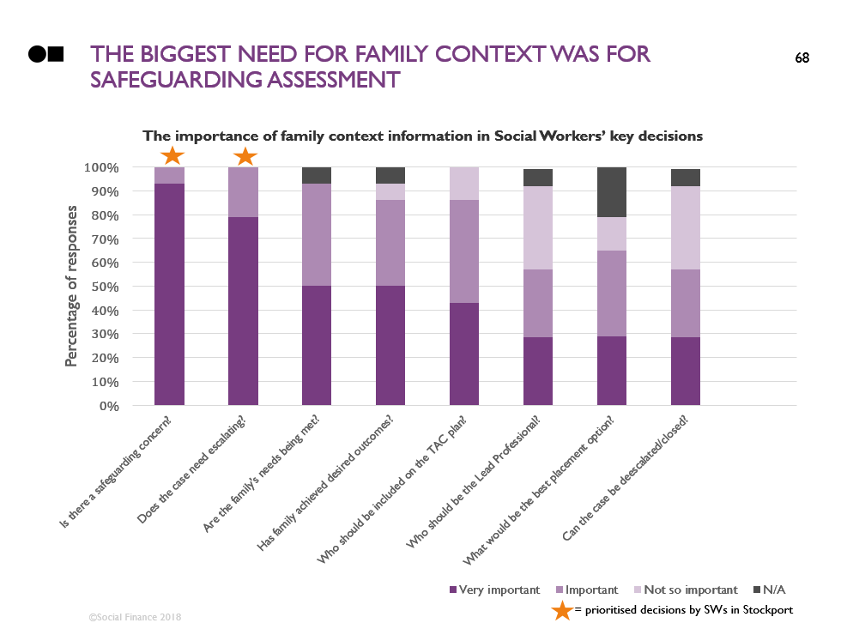
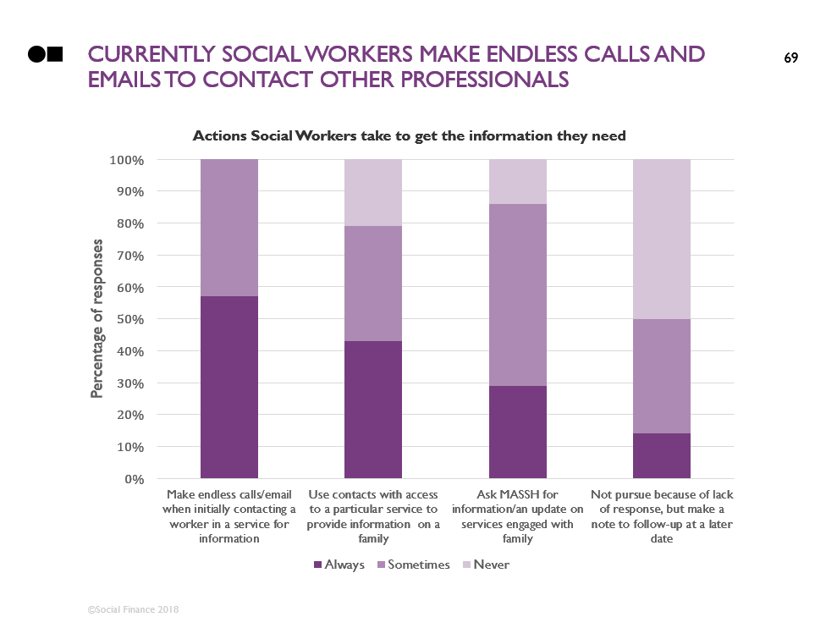
To understand how generally applicable our findings were, we surveyed frontline workers
Which decisions most need family context information?
How do they get access to this information currently?
We sent out a short online questionnaire to 12 Social Workers in Stockport to ask:

Slide 68
The biggest need for family context was for safeguarding assessment
= prioritised decisions by SWs in Stockport

Slide 69
Currently Social workers make large numbers of calls and emails to contact other professionals

Slide 70
CONTENTS
Introduction
Discovery process and methodology
Project deliverables
3.1. Leeds and Stockport specific context
3.2. User overview: needs, workflow and thematic analysis
3.3. Prioritised use case and user requirements
3.4. Business case
3.5. Existing solutions
3.6. User requirements testing
Next steps and plan for Alpha

Slide 71
There are three major benefits to addressing this need
 | Benefit | Description | Impact | Scale
1 | Better support | Social Workers having the right conversations with other professionals meaning they can coordinate support, they know the information families expect them to and they have better engagement with families | Less escalation to social care – better for families and saving significant resources | £100,000 per care placement avoided¹
2 | Better safeguarding | Speaking to other professionals means Social Workers don’t miss risk factors and can verify what families tell them | Risks are picked up and families get the right support the first time | Nationally, over 10% of referrals with no action taken needed statutory support which they didn’t get²
3 | More efficient working | Social Workers save the 2 hours per assessment they estimate they spend tracking down basic information on what services are involved and who the lead professional is | Social Workers save time and can focus on working with families to better address their needs | 2 hours saved per case is equivalent to 4-5 FTE for a mid-sized CSC department
Social care is a key cost driver with provision typically costing in excess of £100,000 for a typical 2 year care period
Action for Children: “The Revolving Door Part 2 – Are we failing children at risk of abuse and neglect?” Of the 220,000 referrals to children’s services in 2013/14 which did not receive any statutuory support, 36,000 (16%) were re-referred in 2014/15, and 22,000 (10%) of these then got statutory support (note that this is all referrals to the Front Door, not just those that go for SW assessment)
Stockport, a mid-sized CSC department, performs 3,500-4,000 social work assessments per year. Saving 2 hours on each of these is a total saving of 7-8,000 hours in a year, equivalent to 4-5 full time staff

Slide 72
1.) better information enables better support for families and ultimately less escalation to social care
What happens currently?
Social Workers’ difficulty finding and speaking to the other services supporting families means:
Support is not always well coordinated between services, there are even cases of two difference services visiting a family on the same day without knowledge of each other
Social Workers don’t always know all the important information. When families expect this, or they have previously told other services, it can “get their back up” and damage the relationship
What if we met this user need?
Social Workers know the important information families expect of them so can have better engagement with families
Social Workers can speak to other services involved where appropriate to provide coordinated support
What impact would this have for children, families and the council?
Social Workers and other professionals have better engagement with families and can provide them with better support
Families get better help to address their issues
Better support for issues will stop them escalating, leading to less children entering care
There could be significant financial savings for the council with care placements costing in excess of £100,000 for a typical 2 year care period

Slide 73
2.) speaking to other professionals stops risks factors being missed and helps ensure children are safeguarded
What happens currently?
With Social Workers currently finding basic information on the services supporting families through ad hoc methods, there is a risk they do not find relevant risk factors
Without speaking to other services, Social Workers cannot verify what families tell them. They report that this can lead to not fully understand a family’s situation
Missing risk factors could lead to not appropriately safeguarding children
Nationally, 23,000 children a year (10% of Front Door referrals with NFA), have to be referred to social services multiple times before receiving statutory support¹
What if we met this user need?
With Social Workers able to quickly see what services are supporting a family, they can get a quick view of potential risk factors
With the contact details for the lead professionals in these services, they can have the conversations required to build an understanding of the risk level and verify what they hear from families
What impact would this have for children, families and the council?
Social Workers can ensure that the right safeguarding decision is made and families get the right support, first time
This means children will be better safeguarded and families will get the right support to address their needs
Action for Children: The Revolving Door Part 2 – Are we failing children at risk of abuse and neglect? Of the 220,000 referrals to children’s services in 2013/14 which did not receive any statutuory support, 36,000 (16%) were re-referred in 2014/15, and 22,000 (10%) of these then got statutory support (note that this is all referrals to the Front Door, not just those that go for SW assessment)

Slide 74
3.) Getting info quickly could save 2Hrs per assessment, equivalent to 4-5 FTE for a mid-sized CSC dept
What happens currently?
Currently Social Workers spend a lot of time tracking down basic details and information on what services are supporting a family and who the lead professional is
Social Workers estimate that this takes on average 2 hours per assessment
This is time Social Workers cannot spare: a significant number of workers mentioned high caseloads and lack of time as major problems, hindering their work and potentially damaging the quality of their support for families
This will also have a significant impact on staff morale, as workers spend time on avoidable admin, rather than work with families
What if we met this user need?
With quick access to the contact details of the lead professionals supporting a family, Social Workers can immediately have the conversations they need
This frees up vital Social Worker time for better engagement with families
What impact would this have for children, families and the council?
Saving 2 hours per assessment is equivalent to 4-5 FTE for a mid-sized CSC department1
Given current high caseloads for workers, this saving would provide vital extra time for workers to engage with families
1. Stockport, a mid-sized CSC department, performs 3,500-4,000 social work assessments per year. Saving 2 hours on each of these is a total saving of 7-8,000 hours in a year, equivalent to 4-5 full time staff

Slide 75
There are also risks in taking this work forward – we have focussed our plan on effectively mitigating these
 | Risks | Description | Mitigations
1 | Technology fatigue | Practitioners have been exposed to a considerable number of tools and systems over the last couple of years and many problems still persist. There is a risk that SWs don’t engage in the process and don’t see the value of the tool and consequently don’t use it | Spend enough time understanding the nuances of the specific SWs needs Spend time understanding the SW workflow and its details Involve SWs in the design process and make sure their feedback is heard and incorporated
2 | Access to data, data quality and technical feasibility | Data on families is recorded in multiple systems by different services in various ways There is the risk that it’s not feasible to access data sitting outside of the CMS and it’s not possible to link data from different sources or that data is too poor quality to be used for decision making | Map datasets that capture family data and systems where and how data is captured Review quality of datasets Capture challenges and learnings from other projects where data has been linked (e.g. Signpost and Child Index)
3 | Information Governance restrictions | Councils need to justify the need to share data between services and link family data There is the risk that the Information Governance gateways are not in place to enable the data sharing required to build and implement a solution | Identify what is the minimum data SWs need on families to improve decision making Clarify why and how the data will improve decision making Engage IG leads through the project Understand specific LAs data sharing processes & IG gateways Build common IG gateways across LAs
4 | Social work practice integration | For increasing the information that Social Workers have to be effective in improving outcomes it must integrate well with Social Work practice and enhance the council’s strategy and approach. There is a risk that, if not worked through carefully, increased information could detract from conversations with families | Work closely with Social Workers to understand practice approaches and how information would affect these Work closely with council leadership to understand strategy and integrate improved data quality with this Focus on data that most enhances conversations with families and other professionals

Slide 76
CONTENTS
Introduction
Discovery process and methodology
Project deliverables
3.1. Leeds and Stockport specific context
3.2. User overview: needs, workflow and thematic analysis
3.3. Prioritised use case and user requirements
3.4. Business case
3.5. Existing solutions
3.6. User requirements testing
Next steps and plan for Alpha

Slide 77
both leeds and Stockport have existing projects that provide some of the functionality that users need
LA | Project | Overview | Meets user needs?
Leeds | Child Index | Child Index is an MDM solution to create an index of IDs across systems. At the moment it incorporates data from Mosaic, Synergy and Insight Outreach (post-16 education database). It is currently being trialled with YOS, Social Care Front Door and NEET tracking teams | This is very useful in linking IDs across systems to build a unique child record, but doesn’t link data on family level
 | Families First database | Families First team have built a platform to record and match data on families from multiple sources (Mosaic, Synergy, Child View – YOS and Police data). The team requires consent from families to add cases to the database | Although FF team has been linking family data across a number of years they have only been doing for families that match the programme criteria and have been doing it in a relatively manual way
 | Mosaic family genogram & chronology | Mosaic is the CMS used by Social Workers and it has the ability to link siblings and other family members and build a family view. Genogram can build a family view but it requires already having data on family members. Group recording is possible but has not been implemented in Leeds | Although Mosaic has the capability to link family members and build a family view there is only a small portion of records with good quality information available. SWs mentioned that the interface is not very user friendly which makes people use paper based Genograms most of the time
Stockport | Signpost | Signpost system is currently used to pull together event data from many different sources and display them side by side in a single view. Current sources include children’s services, adult social care, early help, schools, council tax, YOS and housing data. It is currently being piloted with the MASSH team | Although Signpost has the capability to visualise individual’s interactions with services across time, it currently uses individual level data and not family data
 | Children’s Data Warehouse | The data warehouse is a Master Data Management system collecting data from the CSC CMS (EIS currently), designed to allow for easier reporting and analysis and providing a more comprehensive view of performance | Although very useful in linking IDs across systems to build a unique child record the tool doesn’t link data on family level, just individual

Slide 78
CONTENTS
Introduction
Discovery process and methodology
Project deliverables
3.1. Leeds and Stockport specific context
3.2. User overview: needs, workflow and thematic analysis
3.3. Prioritised use case and user requirements
3.4. Business case
3.5. Existing solutions
3.6. User requirements testing
Next steps and plan for Alpha

Slide 79
To further understand needs We created 3 mock-ups of potential tools & tested them with social workers
Initial family search page
Option 1 – text paragraph
Option 2 – family timeline
Option 3 – genogram

Slide 80
Social workers thought tools with this information would save hours of time per week
Headline finding |  | Details
1 | Basic information on what services are engaged with the family would be very valuable (options 1&2) | “I love this, it gives me a first feel how the family are functioning”. “This would be a dream really” “If I didn’t have this then I would be trying to find this information – this removes the difficult legwork “If the child had no previous CSC contact, you couldn’t normally get this information” Consensus was that this would save hours per week
2 | In particular, contact details for the lead professional in each service was highly valued (options 1&2) | “Having contact details is such a head start” “I would use this to talk to school, police, ASC etc.”. “I would use it for every referral”. “I’d love something like that” “Currently we’re fishing to get this information”
3 | The majority thought this was the right level of information, but some wanted more details (options 1&2) | “This has the facts laid clearly with no value judgements” “These are exactly the right services to know about”. “I wouldn’t want to know more than this” “I would like attendance too”. “I would like to know the details of incidents e.g. police involvement”, another said: “I would just like to know the ref # for the incident”

Slide 81
… and Overall they had a weak preference for information presented as a paragraph vs a diagram
Headline finding |  | Details
4 | On balance people preferred a text output (option1) to a graphical one (option 2) | For those who preferred text outputs (option 1): They could clearly read and understand the information. SWs started forming hypotheses and angles for further investigation The timeline was: “too techy”, “too hard to read”, “reminds me of GCSE maths”, but was ultimately understandable by all For those who preferred graphical outputs (option 2): “This is a quick visual view”, “This has more information”. “You can visualise a bit more. I quite like that: it’s easier to quickly review the family’s background” The paragraph was “a bit dull”, “like reading a book”, or “would be better with a person in the middle”
5 | Some users found option 3 harder to engage with and understand | “This is dizzying”, “If you’re in a rush, you couldn’t look at that and process it”, “Complicated diagram”, “bit like a map”, “hard to read”, “don’t really like it”, “it wouldn’t help me” But others thought it would be of some help: “good as appendix to option 2”, “Although this looks very formal, it gives a better view of the family”, “it would be very helpful to know who is in the family”, “this might be too much info though”

Slide 82
CONTENTS
Introduction
Discovery process and methodology
Project deliverables
3.1. Leeds and Stockport specific context
3.2. User overview: needs, workflow and thematic analysis
3.3. Prioritised use case and user requirements
3.4. Business case
3.5. Existing solutions
3.6. User requirements testing
Next steps and plan for Alpha

Slide 83

We aim to provide social workers an easier way to find what other services are involved
Solution
In alpha we would aim to build a minimum viable product and test this with Social Workers
The priority services for users to know about are Children’s services (CSC and Early Help), Education, Health, Police (e.g. Domestic Violence), Drugs & Alcohol and Mental Health
A tool would need to include not just the individual child, but also their immediate family (parents and siblings as essential, parents’ partners, other people living with the family and other carers if possible) – this could require the development of a family matching algorithm
Our aim is to build something that will work for all authorities. We therefore would want to 1) user test in multiple authorities and 2) build something that works technically for multiple authorities i.e. integrates with any current databases or into source databases
We may be able to do some rapid live user testing using existing tools which provide some of the functionality required (e.g. Stockport Signposts tool)
Assessment
Social Workers

Slide 84
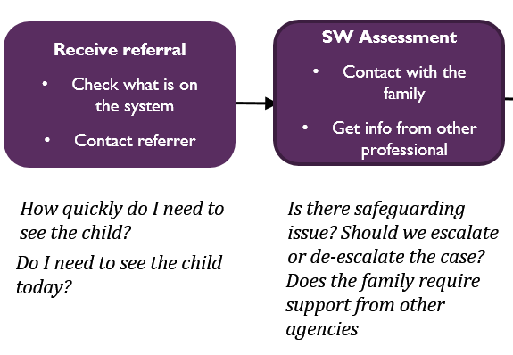
We would target this at the highest need point of the workflow: the initial social work assessment
Common Social Worker workflow and decisions map
REFERRAL
Receive referral
Check what is on the system
Contact referrer
SW Assessment
Contact with the family
Get info from other professional
Plan development
Initial TAF/TAC meeting
Deliver 6-8 focussed intervention sessions
Review plan
Review TAF/TAC meeting every 6 weeks
Escalate to CP
MASH/Front Door
Further CIN/TAC support required
Early Help
Closure/step down to EH -outcomes achieved
Specialist Services
How quickly do I need to see the child?
Is there safeguarding issue? Should we escalate or de-escalate the case?
What services are required to best support the family
Does the parent(s) have the capacity to meet the child’s needs?
Does the family need further support?
Do I need to see the child today?
Is the family ready for FGC?
Is there safeguarding issue? Should we escalate or de-escalate the case?
Can the case be closed? Have the family achieved the desired outcomes?
Does the family require support from other agencies
Use case focus

Slide 85
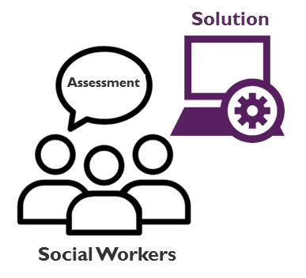
Not knowing who is engaged with the family causes multiple painpoints currently
Current Social Worker SW assessment workflow and painpoints
“The referral can be as little as just one line”
“Sometimes we receive the information on family members through the referral but sometimes we don’t”
It is the worst start when you go and the information isn’t right, it gets parents back up. This happens often and we don’t look very professional, you look like you don’t know what you’re doing
For existing cases, families expect you to know the details: ““You asked me about this last time!”
“Sometimes you need to verify what the family tells you”
Conversations with the family
“If you know the family context then, if mum doesn’t talk about someone you can ask e.g. do you see much of auntie Julie?”
Referral for SW assessment
What support (or challenge) does the family need?
“I visited a family and MST had visited that morning, but I had no idea”
Coordinate and provide the right support
“Sometimes families tell me what other services they have been accessing but a lot of times I will have to spend time ringing GPs, schools, Health Visitors just to get that information.”
Conversations with other engaged professionals
“Conversations with EH are very valuable – schools and police get the restorative philosophy”
”It often requires digging to find out who the lead professional is, particularly with schools”

Slide 86
Our aim is to address this conversations with families and collaboration with other professionals
Ideal Social Worker SW assessment workflow
Social Workers know the relevant context families expect
Multiple services working with a family are coordinated in their support
Conversations with the family
Referral for SW assessment
What support (or challenge) does the family need?
Social Workers can verify what the family says through speaking to other professionals
Coordinate and provide the right support
Social Workers don’t waste time finding basic info like what other services are supporting the family and what their contact details are
Social Workers build strong relationships with families and ensure they get the right support
Conversations with other engaged professionals
Social Workers don’t miss risk factors through not knowing a certain service is engaged with the family

Slide 87
initial plan for alpha
February
March
April
Sprint 1 - 2
Work with IG on data requests and schedule critical path meetings
Kick-off with stakeholders
Initial interviews with users and tech/data leads, focusing on existing solutions (Stockport & Leeds)
Begin work on family matching algorithm, extracting the necessary data taking into account permissions, availability, structure etc.
Sprint 3 - 5
Develop mock-ups and wireframes for initial user testing
Develop MVP: a simple view of which services are engaged with a family (limited based on availability of data)
Iterate family matching algorithm design
Test with users against need
Iterate prototype with release each sprint for ongoing user testing
Sprint 6 - 8
The prototype sol. developed (incl. final iterations and testing)
User research report on needs and if/how prototype meets these
Business case on impact on children’s outcomes, time/cost saving for users and costs of beta &live
Beta plan: what to build, plan, team requirements etc.
Beta-gateway – assess whether to progress to beta with key stakeholders

Slide 88
Delivering alpha will require a multi-disciplinary team
Core team requirement
User researcher / product designer – lead on user testing and UI/UX design
Developer – to build the prototype tool for Social Workers
Data scientist – to develop a matching algorithm to identify families within data, work on matching individuals between services and lead on data quality testing
Business / Data analyst – to support across the work on matching approaches, IG and data availability/sourcing, developing materials, capturing artefacts, partner engagement, user research etc.
Project manager – to manage the project and coordinate product development
Local authority core team requirement
Social Workers – 3-5 SWs per authority to try the tool
Developers / Database managers – to support access to the data from current systems
Project management – to coordinate the support and steer the work (with senior leadership)

Slide 89
Children Services Acronyms list
ACS - Administration for Children's Services
AIP - Area Inclusion Partnerships
CAMHS - Child and Adolescent Mental Health Services
CIN – Child In Need
CMS – Case Management System
CPP – Child Protection Plan
CSC – Children Social Care
CwCN – Child with Complex Needs
CWD – Children with Disabilities
CYP – Children and Young People
EH – Early Help
FGC - Family Group Conferences
FIS - Family Intervention Services
FNP – Family Nurse Partnership
HYMs - Healthy Young Minds
ICPC – Initial Child Protection Conference
IG – Information Governance
IRO – Independent Reviewing Officers
LA – Local Authority
LAC – Looked After Child
LAIT – Local Authority Interactive Tool
LGM – Legal Gateway Meeting
LPM – Legal Planning Meeting
MAARS – Multi Agency Adults at Risk System
MAPPA - Multi-Agency Public Protection Arrangements
MARAC – Multi-Agency Risk Assessment Conference
MASE – Multi Agency Sexual Exploitation
MASH/MASSH – Multi Agency Safeguarding Hub
MFH – Missing From Home
MST – Multisystemic Therapy
NEET – Not in Education or Employment
NFA – No Further Action
PLO – Public Law Outline
RES – The Restorative Early Support
RIO – Referral Information Officers
SEMH – Social, Emotional and Mental Health panel
SEND – Special Education Needs and Disability
SILCs – Specialist Inclusive Learning Centres
SW – Social Worker
TAC – Team Around Child
TAS – Team Around School
TSL - Targeted Services Lead
YOS – Youth Offending Service

